Slide 1


Unlocking Potential by “getting it right first time”
Patrick Clark
Sharon Smith
Richard Woolley

Slide 2


Longstanding commitment and reputation
Development of SCIPS (supported by HEFCE funding)
https://scips.worc.ac.uk/
GUIDE Project (Erasmus+)
http://www.guideproject.eu/
Toolkits
Inclusive Assessment Policy
https://www2.worc.ac.uk/aqu/documents/Inclusive_assessment_and_reasonable_adjustments_policy_and_procedures.pdf
Busy Lecturers’ Guide
https://rteworcester.files.wordpress.com/2017/03/busy-lecturer-guide-final.pdf
SCALE Project (Erasmus+)

Slide 3

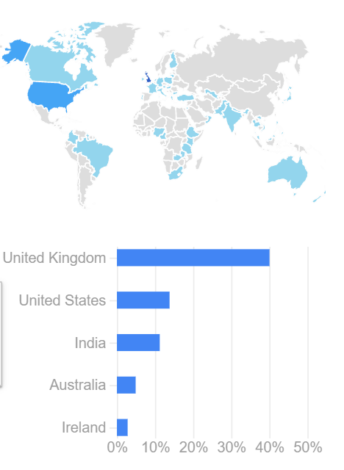
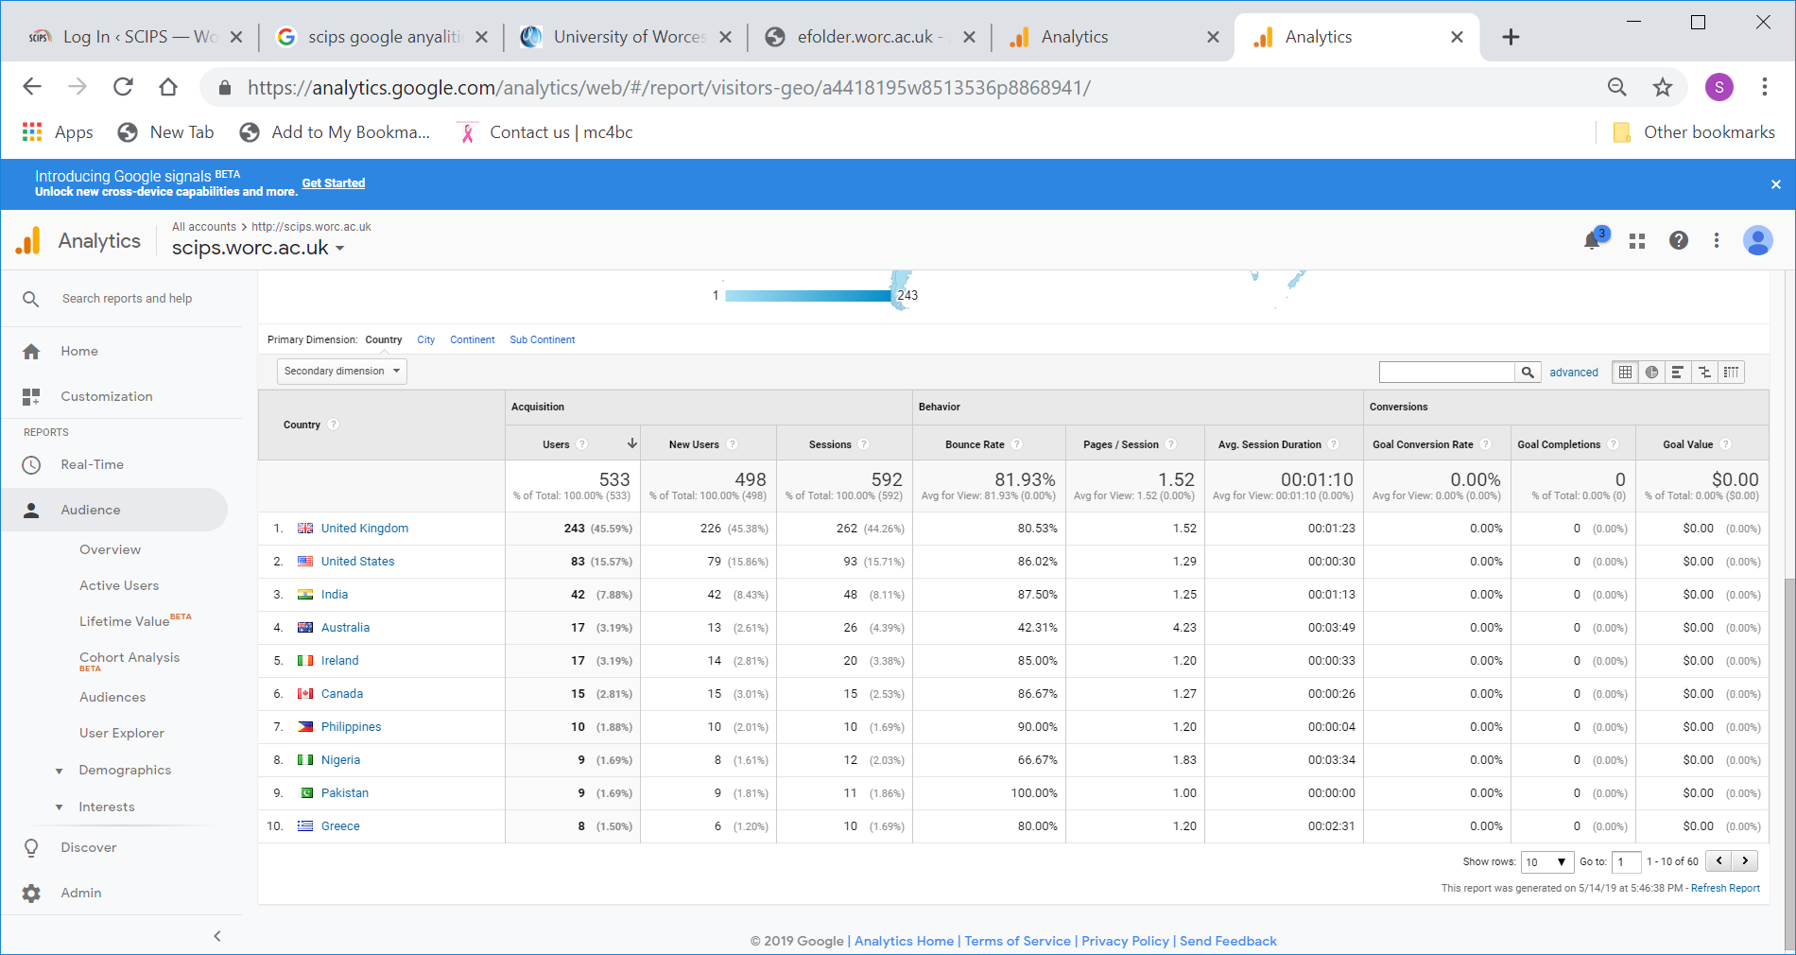
Longstanding commitment and reputation
SCIPS has been used worldwide

Slide 4

Need | Number
Dyslexia | 21
Mental Health/Anxiety | 19
Physical Needs | 12
Dyscalculia | 10
Autism | 9
ADHD | 6
Other | 4
1. English as Additional Language 2. Epilepsy, schizophrenia, borderline personality disorder, Tourette’s 3. Speech and Language needs 4. Epilepsy
Do you have experience of teaching students with specific needs?
In the UK, 100% (n = 22) said yes.

Slide 5
What areas do you need more support with, if any?
Need | Number
Mental health and anxiety | 8
Dyslexia | 5
Autism | 3
ADHD | 3
Physical need(including Visual and Hearing) | 2
General study skills (for all) | 2
Suicidal students | 1
How to work with support assistants | 1
Dyscalculia | 1
Workplace modules (adaptation) | 1
Indigenous students (Australia) | 1
Depends on what you mean by “need” | 1
Don’t know | 1

Slide 6



Sustaining and developing resources
Contact us through the SCALE Project:
E-mail: scale@worc.ac.uk
Webpage: https://www.worc.ac.uk/about/academic-schools/school-of-education/education-research/scale-project.aspx
LinkedIn: tbc

Slide 7
SCIPs and other tools The context

Slide 8

Challenges
Increased student:
  numbers
  complexity
  expectation

Slide 9
Growing student numbers
50% increase in 5 years
Increase of 430 students in past 3 years
1559 students with declared disability in 2017/18
13.9% of student population

Slide 10
Challenges: Growing complexity

Slide 11
Challenges: Growing complexity
Notes:
Numbers tripled in the past five years

Slide 12
Challenges: Growing complexity
Notes:
Doubled over last 5 years

Slide 13
Challenges and opportunities: External factors
Funding changes
  Reduced support in some areas
  Uncertainty about who provides support
  Bureaucracy – diverting limited resources
Legislation - Anticipatory duty on HEPs
Push towards inclusive teaching practice
Universal Design (and UDL)
Student (and parental) expectation
TEF / REF / KEF / OfS / CMA / GDPR

Slide 14
The Worcester response
SCIPS / SCALE Project
Inclusive Practice Toolkit
Inclusive Assessment Policy & guidance
Busy Lecturers’ Guide
Workshops, Share and Inspire events and conferences
  Inclusive practice
  Universal design & UDL
PG Cert HE
Assistive technology

Slide 15
The Worcester response
Collaboration between academic and professional services
Disability and Dyslexia Service
  Delivering support and advice
    Students and
    Staff
Using disability as a lens through which to explore inclusive practice and Universal Design
  “Imagine” case studies
  SCIPs scenarios

Slide 16
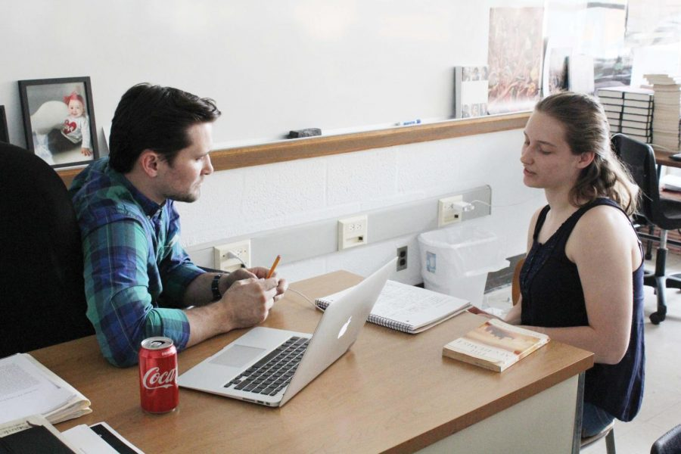
https://scips.worc.ac.uk/
Examples of using SCIPS as an Academic

Slide 17

Celebrating SCIPS – from down under
In my current role as a Teacher Consultant (TC) for students with disabilities in the areas of learning and mental health, I offer teaching and learning strategies to classroom teachers and Head Teachers (HT).
These learners and teachers are in TAFENSW (Technical and Further Education New South Wales). The faculties I work with are Horticulture, Business, Aged and general Health Care, Community Services, Tourism, Hospitality, Information Technology, Pathways into further study, Education, Animal Studies, and general apprentice areas of trades such a Building and Carpentry.
Following an interview with the learner, an Individual Education Plan is devised. That plan outlines the reasonable adjustments, as per the Disability Discrimination Act 1992 (https://www.asqa.gov.au/sites/default/files/FACT_SHEET_Providing_quality_training_and_assessment_services_to_students_with_disabilities.pdf?v=1508135481), that become part of the suggested recommended teaching and learning strategies provided to the relevant teaching staff.
“The site SCIPS is used on a daily basis, with the acknowledgment of each page cited as a source, not only for correct reference, but in the hope relevant staff (tutors included) explore the site to enhance their knowledge of disabilities, as well as increase their teaching and learning practices. The feedback from staff has only been positive.”

Slide 18
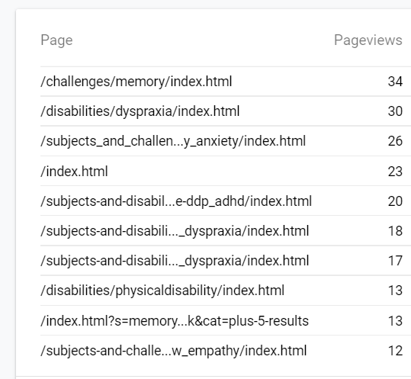
Data for April
2019

Slide 19
At University of Worcester
SCIPS has had impact on Learning and Teaching as it has raised awareness of personalising learning. The impact of changes to the Disability Students Allowance (DSA)? has meant staff have had to be more responsive to students’ entitlements. SCIPS provides an explanation of a particular need and strategies to support it, the site also links to other online resources including videos etc. SCIPS enables academics and trainers to understand students’ needs and explore new methods of teaching to enable the students to learn effectively.

Slide 20
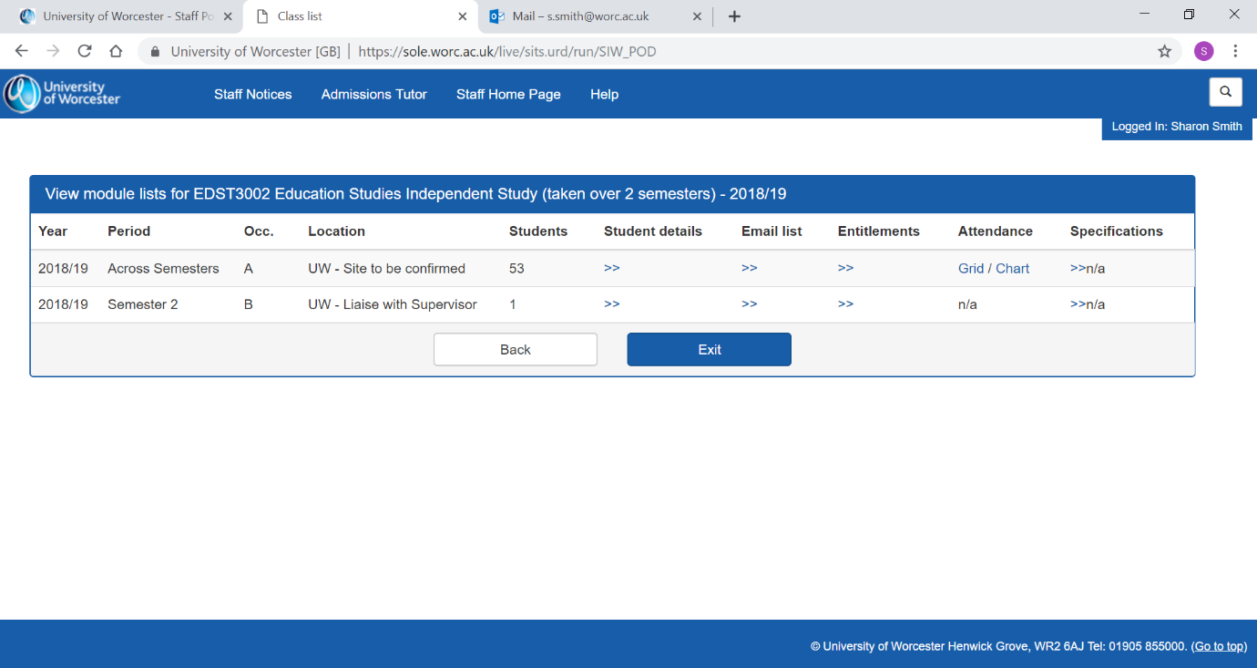

Slide 21
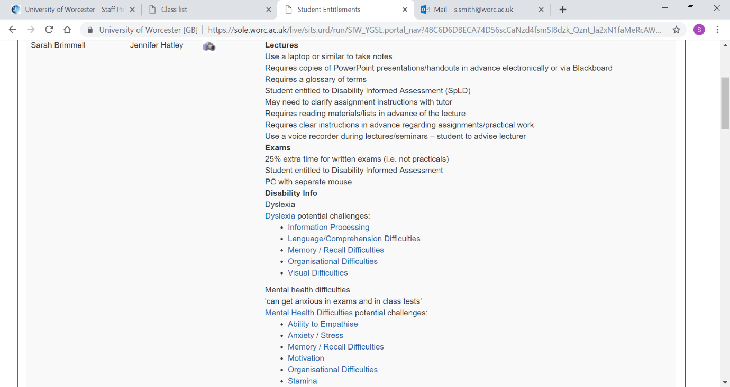
Student details in SOLE

Slide 22
Student A Support needs
In lectures
Use a laptop or similar to take notes
Requires copies of PowerPoint presentations/handouts in advance electronically or via Blackboard
Requires a glossary of terms
Student entitled to Disability Informed Assessment (SpLD)
May need to clarify assignment instructions with tutor
Requires reading materials/lists in advance of the lecture
Requires clear instructions in advance regarding assignments/practical work
Use a voice recorder during lectures/seminars – student to advise lecturer
Exams
25% extra time for written exams (i.e. not practicals)
Student entitled to Disability Informed Assessment
PC with separate mouse
Disability Info
Dyslexia
Dyslexia potential challenges:
Information Processing
Language/Comprehension Difficulties
Memory / Recall Difficulties
Organisational Difficulties
Visual Difficulties
The area in blue are direct links to SCIPS and provide information of how to support the student.

Slide 23
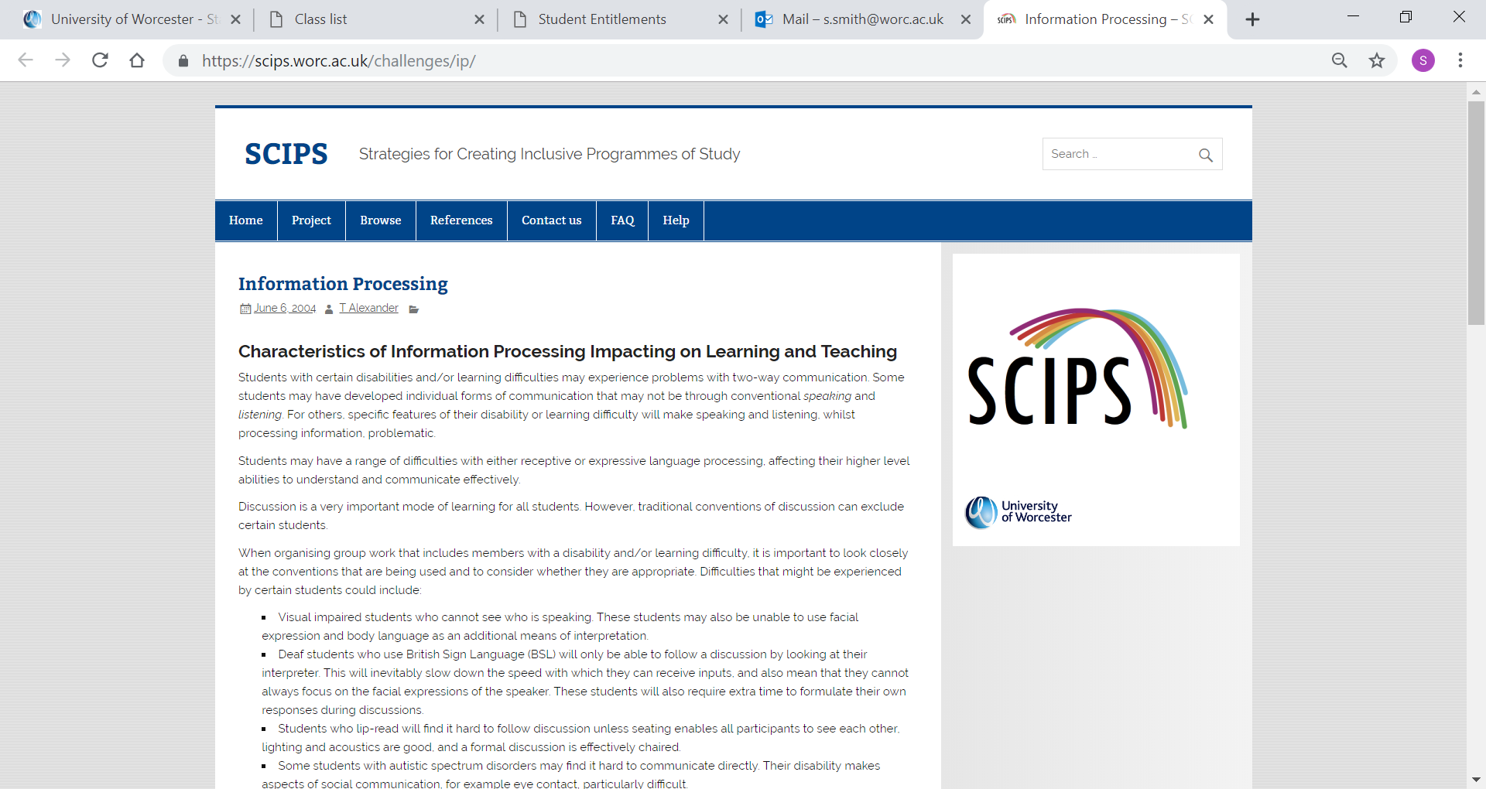

Slide 24

Developing Inclusive teaching
Most of the staff who are new to the university undertake the Post Graduate Certificate in Learning and Teaching in Higher Education (PGCert LTHE). The PGCLTHE is accredited by both the Staff and Educational Development Association (SEDA) and the Higher Education Academy (HEA). Members of the course team are experienced tutors who engage in pedagogic research and have received recognition for their excellent HE teaching.
This course will provide an opportunity for staff to gain knowledge, understanding and capabilities in learning, teaching, assessment and academic practice, and will help you to develop clear professional values, understand teaching as facilitating learning and improve your practice in a reflective, scholarly and theoretically informed way. https://www.worcester.ac.uk/courses/learning-and-teaching-in-higher-education-pgclthe.aspx

Slide 25
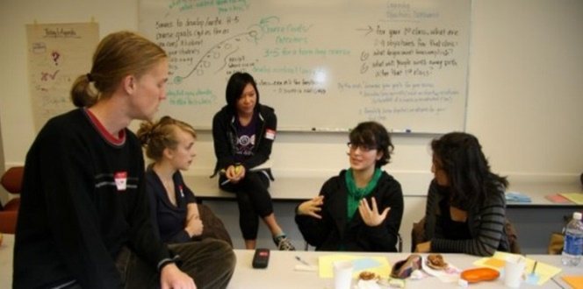
Developing teaching practice
As a member of the university staff are committed to providing excellence in education and as part of the Strategic plan 2019, it is recognised that “we will promote educational and social inclusion and equality”. https://www.worcester.ac.uk/about/university-information/strategic-plan.aspx
The university recognises that :
“disabled students should arrive at university confident that any barriers to their learning have been identified, understood and appropriate steps taken to reduce their impact. The learning environment should be as inclusive as possible, so that individual interventions are the exception, not the rule”
www.worcester.ac.uk/disabilityanddyslexia

Slide 26

Using SCIPS – “Imagine” case studies

Slide 27
Using SCIPS – “Imagine” case studies
Scenario One – Dyspraxic student with physical impairment
Scenario Two – Autistic student with social anxiety
Scenario Three - Dyslexic students
Using SCIPs

Slide 28

Table discussion - Scenarios
Read scenarios
Discuss with neighbour
  How do you feel?
  What do you do?
Who benefits from last scenarios?
Where can we get help?
SCIPs

Slide 29
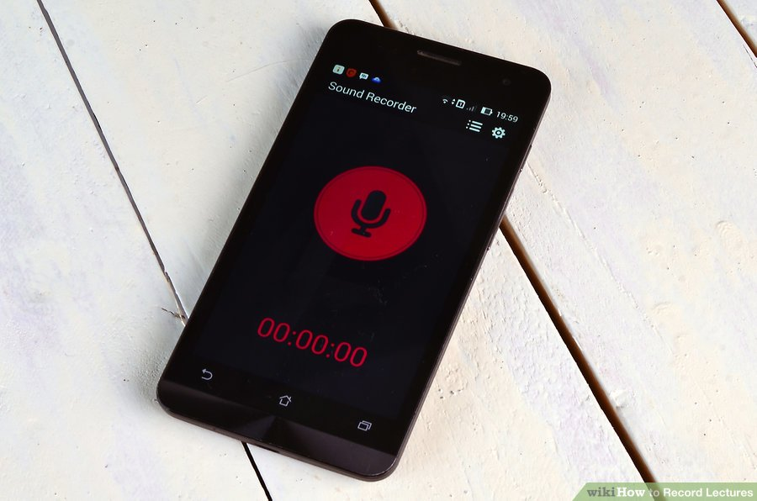





Slide 30
Using SCIPS – “Imagine” case studies
Use SCIPs (and DDS1 Student Support Plan) to identify appropriate strategies and support
Ask learners to consider the case studies
From the perspective of the disabled student
  What does the absence of an adjustment mean?
  What is the impact of the adjustment?
  Wider benefits - Wouldn’t everyone benefit?

Slide 31
Reference
All images from Creative Commons . Bing

