Slide 1
Integrating inclusive assessment with inclusive teaching: the SOAS experience and the challenge of choice
Angus Lockyer
Associate Director
Learning Environment and Student Outcomes
Carol John
Learning Advisor, Disability and Neurodiversity Coordinator
Student Advice and Wellbeing

Slide 2
The next hour (or less)
the SOAS experience:
  where we started
  what’s happened (two acts)
  where we are now
the challenge of choice:
  how do we make assessment inclusive when anything goes?
takeaways

Slide 3
I. The soas Experience

Slide 4
starting points
reasonable adjustments (Student Advice and Wellbeing)
5,200 students; 3,200 undergraduates
230 study inclusion plans
600 special exam arrangements
BME attainment gap (in the classroom))
2017/18 15%
2016/17 17% (London HEIs 34%)
2015/16 31%
institutional context
research-intensive culture
silos: academics vs? professional services; departments; indivs
restructuring: defacultisation; professional services

Slide 5
first steps
inclusive assessment labs (HEA)
decolonising learning & teaching toolkit (inhouse)
unconscious bias training (inhouse)
problems:
conceptual fragmentation
redundancy and time commitment
opt-in (usual suspects)

Slide 6
inclusive SOAS
animating vision: from discrimination, underpinned by unconscious bias, to inclusion, motivated by social justice
desired change: from my module to their programme
1. learning outcomes ->
2. inclusive assessment ->
3. inclusive pedagogy ->
4. decolonised curriculum
initial intervention: two full-day workshops
Day 1: conceptual basics and practical tools
Day 2: application – remapping assessment; rethinking curricula

Slide 7
1. student-centred, programme-level learning outcomes
from: do they know what’s in my head after this module?
to: what can they do at the end of their programme?
what’s a programme for?
  employability (neoliberal? unavoidable)
  socialisation (neoconservative? traditional academic)
  social transformation (utopian? critical)

Slide 8
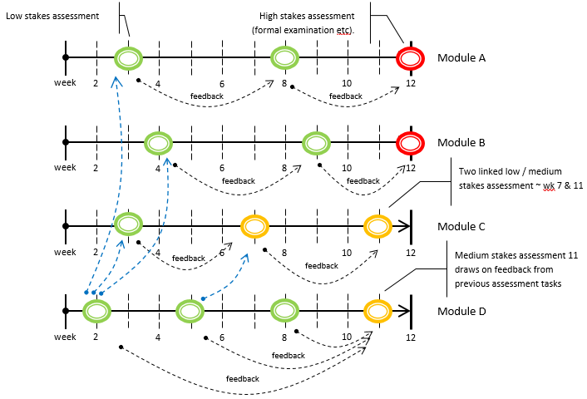
2. inclusive assessment
principles:
programme-level approach
student’s learning journey
diversity of types
balanced through years
students as partners

Slide 9
3. inclusive pedagogy
Cultivate an Affirmative Environment
Attention, Affirmation, Warmth
Remove opportunities for bias/discrimination
Anonymous marking
‘Centre’ the student
Enable connections with their own interests, points of identification, pathways, histories
Skill them for the things they want to do
Ensure Accessibility and Transparency
Reading and background materials
Rules and regulations
Mandate important activities (e.g. academic advice)
Enable deep reflection / critical thinking skills
Set specific and legible assessible tasks
Have clear performance expectations
Personal / inst mechanisms to address poor behavior, conflict
Ensure opportunities are equally accessible
High Expectations, Constructive Feedback
Voice, Space, Power (ensure distributed equitably)
Dialogic space for learning: be accountable / responsive

Slide 10
4. decolonising the curriculum
What ideas, debates, traditions, perspectives, vocabularies are considered “core”?
Who are the ‘authoritative knowers’ and role models in the syllabus?

Slide 11
where we are
5/11 departments (6 next), with priority to those with clearly identified attainment gap / non-continuation issues
delivered 5 x day 1s, 2 x day 2s (3 more to go)
what happened?

Slide 13
the $1m question
how do we move from one-off interventions to simple routines: how do we incorporate inclusivity into everyday practice, annual workflow
questions?

Slide 14
II. The Challenge of choice

Slide 15
what would happen if we really centred the student?
the problem with (at least) undergraduate education
do the world and its problems fall into disciplinary containers?
is any 18-year-old ready to study one thing?
does studying one thing give our students the skills they need?
75% of graduates make no use of their degree
Liberal Arts as a solution
flexibility: designing your own intellectual journey
interdisciplinarity: studying more than one subject
reflexivity: learning how to learn
employability: thinking critically, complex problems, teamwork

Slide 16
BA Global Liberal Arts degree structure
track year | skills | global | regional | language / open option
Y1 | Writing Well / Using Numbers | guided option | guided option | guided option
Y2 | Project Design and Research Methods | guided option | guided option | open option
Y3 | Dissertation | guided option | guided option | open option

Slide 17
task
how would you make assessment inclusive given that almost anything goes?

Slide 18
III. Takeaways

Slide 19
wicked problems … useful questions?
how do we practice inclusivity in an industry built on discrimination?
how do we convince academic (and other?) colleagues that they don’t have all the answers?
how do we encourage people trained as solo contributors (in universities …) to work in teams?
how do we centre the student when they don’t know what they want?

