Slide 1
Learning By Doing:
Experiments In Alternative Assessment
At The Arts University, Bournemouth.
Dr Steven White: Academic Practice and Development Manager
Dr Jon Croose: Senior Lecturer, Contextual Studies, BA Hons Costume with Performance Design
Arts University Bournemouth

Slide 2
Workshop Aims
Consider the notion of ‘alternative assessment’ as ethics and practice.
Share experiences from our experiments with alternative assessment.
Discuss the benefits and challenges of alternative assessment processes.
Facilitate discussion and further the development of your own ideas for alternative assessment in your individual learning environments.

Slide 3
TASK 1: Definition(s)
What's your understanding of alternative assessment?

Slide 4
Types of alternative assessment
Three different approaches to adaptation of assessments have been characterised as:
Contingent approach - special arrangements available for particular students
Alternative approach - choice available to particular students
Inclusive approach – flexible range of assessments available to all
Waterfield and West (2006: 15)

Slide 5
What is Alternative assessment?
The design and use of fair and effective assessment methods and practices that enable all students to demonstrate to their full potential what they know, understand and can do.
(Hockings, 2010, p.2)

Slide 6
The aUB Experiment: context
Contextual Studies: BA Hons Costume with Performance Design
Aims:
Developing Cultural Understanding:
Exploring how practice in costume and performance design communicates cultural conditions and critical ideas.
Developing Academic Skills:
The ability to carry out research and develop critical thinking.
Academic essay writing skills.
L4: Practice In Context: Learning the ropes.
L5: Specialist Practice: Developing critical independence
L6: Research Project: Independent: Read, Research, Write.
L6: Research Project: Written Dissertation of 5,000 words.

Slide 7
The aUB Experiment:
Milestones
2014-16
Re-design of ‘academic’ units on a highly practical, creative course.
Critical theory approach. Core theory text introduced.
Student resistance to reading and writing: underdeveloped literacy skills and perceived high levels of dyslexia.
Low student satisfaction with written units.
Student evaluation informed unit development.
2016-17: First adjustments:
Additional seminar sessions on academic writing, essay structuring and academic protocols were scheduled in response to student feedback.
Writing Frames / Essay Planning Grid.
Text Management: Essay Layout Template.
Reading Support: Quotes Bank / Digested read.
Quick Guides: Referencing and Academic Protocols.

Slide 8
The aUB Experiment:
Milestones
2017-18
94 students
Had not had the benefit of the new scaffolded learning in Level 4 / 5
20 students (18%) applied for extensions due to dyslexia, health or personal problems
Increase in lower grades and referrals.
Many students lost marks due to problems with spelling, written expression and layout.
General literacy skills considerably lower than for previous years.
Pilot:
Successful trial of alternative assessment to replace 5000wd essay:
Reduced written component: Research Planning Grid
Verbal / Visual presentation
Viva exam.

Slide 9
The aUB Experiment:
Milestones
Reduced written component:
  Completed Research Planning Grid shows bullet point theory explanations, selected quotation, referencing, costume detail and critical argument.
Verbal presentation:
  20-minute visual / verbal presentation that reflects the critical structure and evidence.
Viva exam:
  10 minute Q&A with staff. Clarifies student understanding of Theory / Costume detail / Wider contexts.
Section | Point /Claim: | Theory to support point /claim: | Garment / Scenography: | Wider reading: | Conclusion and link to next point.
Critical Idea from theory | Explain the critical focus of the point | Offer relevant quotation from theory explain any specialist terms Reference all sources correctly | Describe costume and / or scenography detail from case study How do costume and / or setting communicate meaning related to the theoretical point? | Explain, quote and reference wider research reading about case study, or genre, that supports the critical point. Reference all sources correctly | What do we learn from this evidence and how does it lead to the next idea?
1 | 1 2 3 | 1 2 3 | 1 2 3 | 1 2 3 | 1 2

Slide 10
The aUB Experiment:
Milestones
2018-19
First cohort with 3-year scaffolded learning process
The average mark improved (65). Referral rate down.
98% student satisfaction for the unit.
Alternative assessment process offered to 12 students as a 'reasonable adjustment' according to their individual needs (repeated referral, 42-48 grade boundary, dyslexia, general literacy).
NB HEFCE review of policy (2009): A “blanket” policy of set adjustments according to certain impairments is likely to be unlawful because it cannot be material to the facts of the individual case. Therefore, there should be clear processes for making reasonable adjustments for individual students.
Option accepted by 4 students, with two passes at 58 / 62 and two Referrals. (40 / 38).
Even dyslexic students can find it hard to let go of the written word.
This process has implications with regard to extra assessment time.
Extra teaching support is needed for students who choose this option, i.e: Presentation skills

Slide 11
TASK 2: Options
The AUB Costume experiment is still very tied to the written word as an outcome that demonstrates knowledge.
What appropriate options exist for alternative assessment in your context?

Slide 12



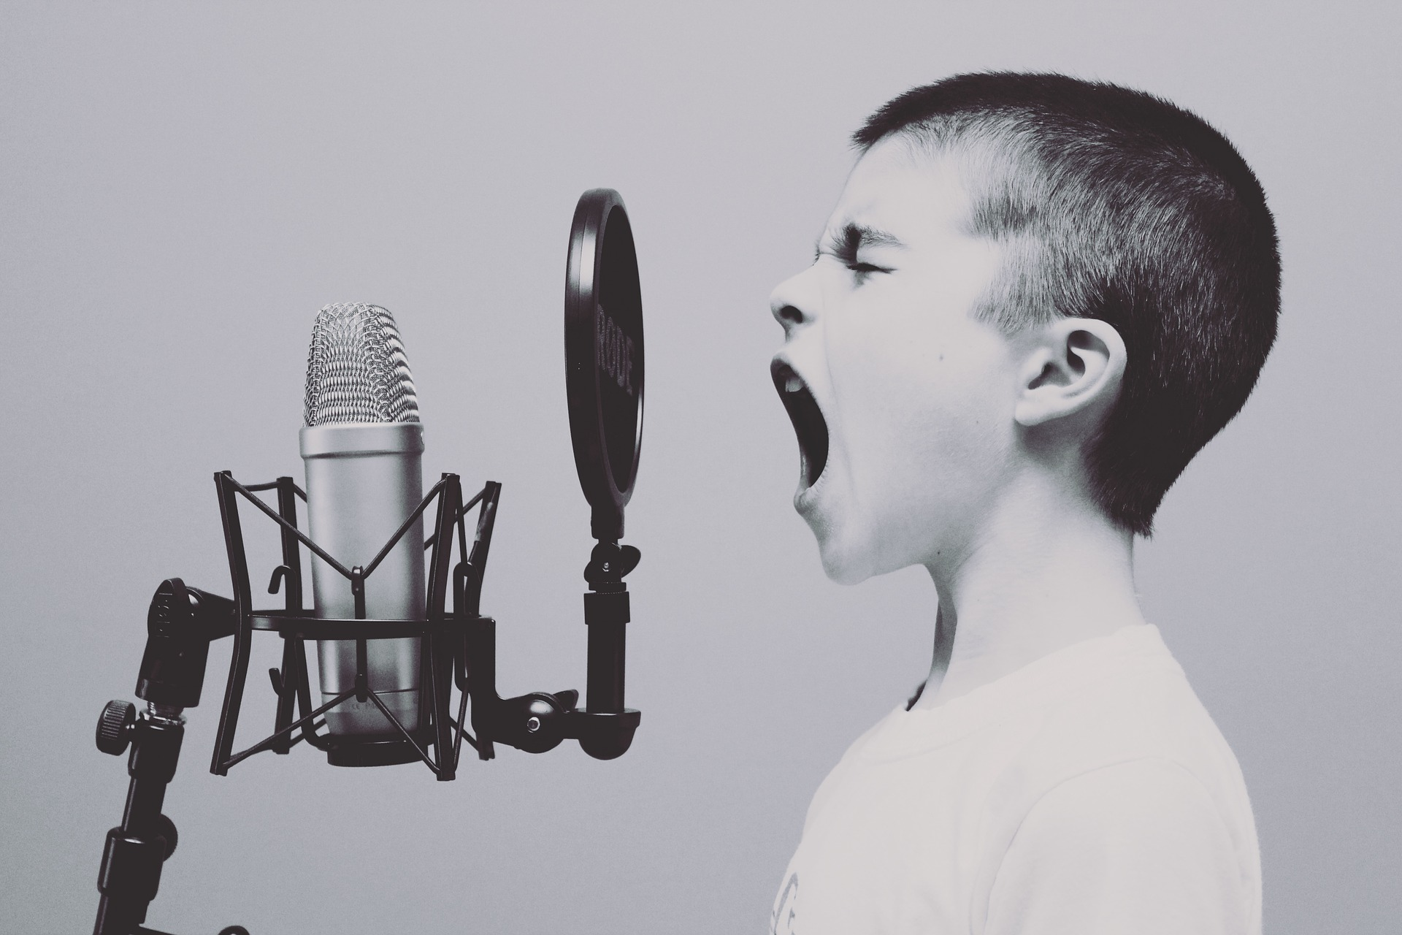



Texts “should reflect the purposes of the arts, not those of the society or the institutions within which it is carried on” (Borg, 2007:99).
Alternatives to essays?
Notes:
texts “should reflect the purposes of the arts, not those of the society or the institutions within which it is carried on” (p.99).
Visual essays, mood boards, collage arguments, post-it structures, In-class tests, MCQs, Viva voce, Self and peer assessment, Annotated bibliographies, Solo or group presentations Reflective diaries / logs, performance, creation of audio visual material, laboratory work
BORG (2012): Use a simplified collage of texts from research (or visual representations of them), then draw relationships between
them, assembling them into a physical patchwork, which can then be converted more easily into written connections.“By physically assembling the texts into a patchwork, students can be brought to see ownership of the original texts and the links that can be drawn among them” (Borg, 2012, p. 12). Similar technique is used in architecture at AUB – collage writing
Dandelions:
Image by <a href="https://pixabay.com/users/Monsterkoi-65294/?utm_source=link-attribution&amp;utm_medium=referral&amp;utm_campaign=image&amp;utm_content=2817950">Monsterkoi</a> from <a href="https://pixabay.com/?utm_source=link-attribution&amp;utm_medium=referral&amp;utm_campaign=image&amp;utm_content=2817950">Pixabay</a>
Board:
Image by <a href="https://pixabay.com/users/geralt-9301/?utm_source=link-attribution&amp;utm_medium=referral&amp;utm_campaign=image&amp;utm_content=218535">Gerd Altmann</a> from <a href="https://pixabay.com/?utm_source=link-attribution&amp;utm_medium=referral&amp;utm_campaign=image&amp;utm_content=218535">Pixabay</a>
Zebra:
Image by <a href="https://pixabay.com/users/40038-40038/?utm_source=link-attribution&amp;utm_medium=referral&amp;utm_campaign=image&amp;utm_content=1904246">40038</a> from <a href="https://pixabay.com/?utm_source=link-attribution&amp;utm_medium=referral&amp;utm_campaign=image&amp;utm_content=1904246">Pixabay</a>
Post its:
Image by <a href="https://pixabay.com/users/Pexels-2286921/?utm_source=link-attribution&amp;utm_medium=referral&amp;utm_campaign=image&amp;utm_content=1284667">Pexels</a> from <a href="https://pixabay.com/?utm_source=link-attribution&amp;utm_medium=referral&amp;utm_campaign=image&amp;utm_content=1284667">Pixabay</a>
TV:
Image by <a href="https://pixabay.com/users/AlexAntropov86-2691829/?utm_source=link-attribution&amp;utm_medium=referral&amp;utm_campaign=image&amp;utm_content=2213140">Alexander Antropov</a> from <a href="https://pixabay.com/?utm_source=link-attribution&amp;utm_medium=referral&amp;utm_campaign=image&amp;utm_content=2213140">Pixabay</a>
Audio:
Image by <a href="https://pixabay.com/users/Free-Photos-242387/?utm_source=link-attribution&amp;utm_medium=referral&amp;utm_campaign=image&amp;utm_content=1209816">Free-Photos</a> from <a href="https://pixabay.com/?utm_source=link-attribution&amp;utm_medium=referral&amp;utm_campaign=image&amp;utm_content=1209816">Pixabay</a>

Slide 13
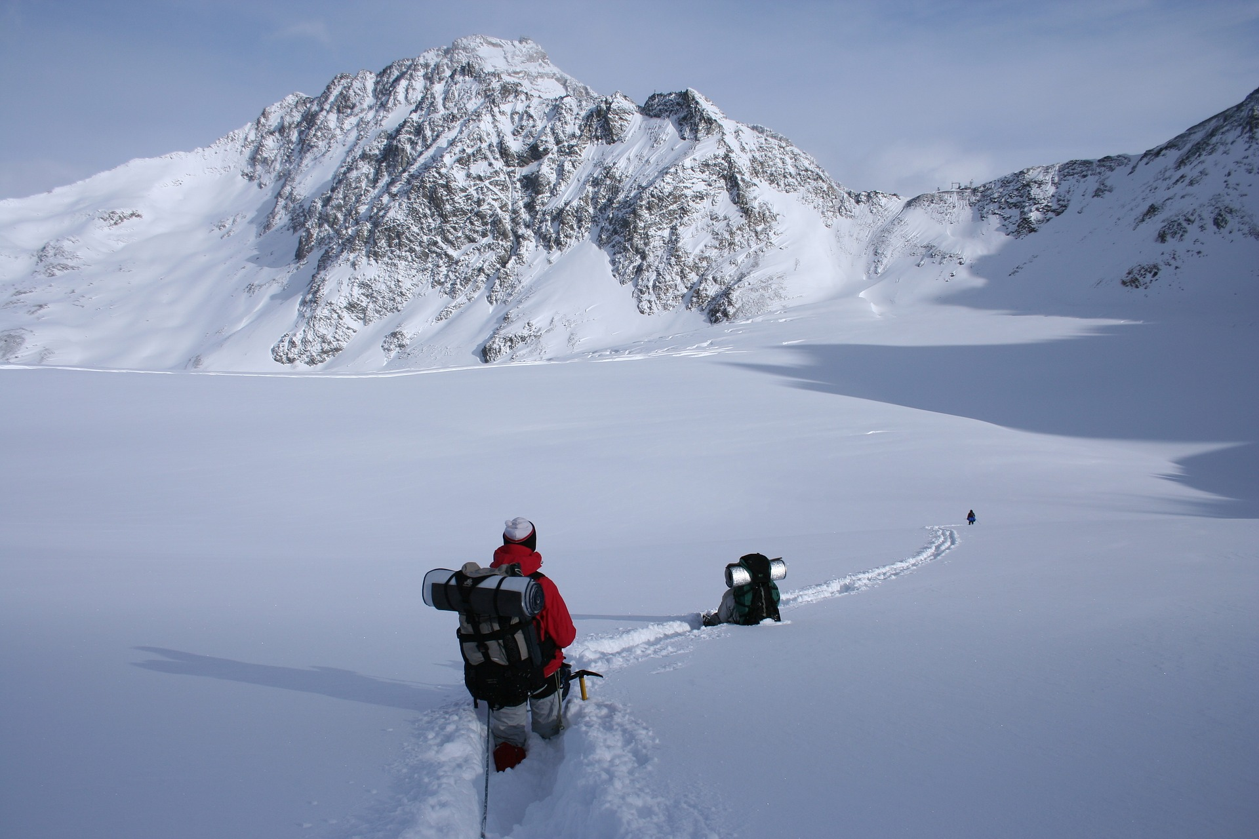
Alternatives to essays?
Students in arts institutions often find writing "constraining and difficult … and at worst painful in itself" (Borg, 2012: 6)
Notes:
Resist a ‘linguistic imperialsm’ of valuing writing in itself over other forms of expression" (Borg, 2012)
Also need to make explicit the aims behind assessments: "that professional practice can be enhanced by the development of a critical awareness that requires distance from practice itself may never be explicitly articulated by university teachers" (Haggins, 2006: 525).
Image by <a href="https://pixabay.com/users/arvarga-3678863/?utm_source=link-attribution&amp;utm_medium=referral&amp;utm_campaign=image&amp;utm_content=1796562">Adam R</a> from <a href="https://pixabay.com/?utm_source=link-attribution&amp;utm_medium=referral&amp;utm_campaign=image&amp;utm_content=1796562">Pixabay</a>

Slide 14
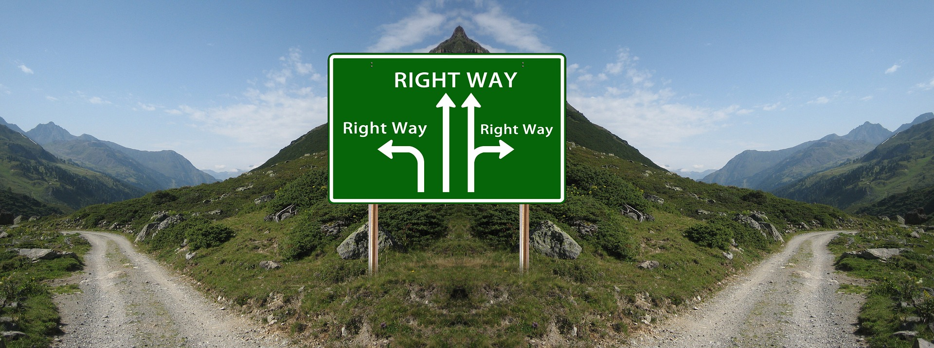
Need a "range of alternative assessments scaffolded by early formative work and timely feedback" (Butcher et al., 2010)
Alternatives to essays?
Constructive alignment
Clear and transparent criteria
Timely and constructive feedback (Craddock & Matthias, 2009)
Notes:
Overall criteria for inclusive assessment = similar for general assessment: (1) constructive alignment (2) clear and transparent criteria (3) timely and constructive feedback (University of Plymouth – 7 steps to inclusive assessment).
BUT: Criteria can be confusing for students in HE (Grainger et al., 2008)
- Need to understand underlying priorities in assessment of A&D contexts: Orr and Bloxham find lecturers look for (a) demo significant learning over time (b) demo of effective studentship (c ) present meaningful A&D work. (these are inter-related, imprecise and sometimes not very transparent criteria).
Assessment for learning model (feedback + ongoing support), challenge binary separation of formative and summative asst (McDowell et al. 2011) [from Orr & Bloxham, 2012].
Image by <a href="https://pixabay.com/users/geralt-9301/?utm_source=link-attribution&amp;utm_medium=referral&amp;utm_campaign=image&amp;utm_content=680607">Gerd Altmann</a> from <a href="https://pixabay.com/?utm_source=link-attribution&amp;utm_medium=referral&amp;utm_campaign=image&amp;utm_content=680607">Pixabay</a>

Slide 15
TASK 3: Challenges
What are the challenges of adopting alternative or inclusive assessments in your context?

Slide 16

Challenges: disciplinary contexts
Inclusive approaches to pedagogy [and assessment] require a focus on collective exploration of how to learn (and how to demonstrate learning) in particular disciplinary contexts. (Haggis, 2006, p.530)
Notes:
Despite A&D context, language is still central (in kind of exchange) where artefacts are 'constructed/represented' through language, not just interpreted.
No deficit model + can't respond to all students specific needs at all times THEREFORE need social model + academic lits approach.
Need to highlight the fact that academic expectations can be hard to understand for students (Laurillard, 2002, Rethinking University Teaching) (especially amongst increasingly diverse cohorts), and so we need to "create pedagogical situations where students can understand, expereience, interpret and react to dsciplinary conventions" (Haggis, 2006, p.530). This is how 'we' think/argue/make/work/value ...
Ideas of independent learning, learner responsibility, 'deep' approach to learning, reflective practitioner are "not neutral truths" of education (Haggis, 2006: 524).
Students need to understand terms like 'analysis', 'argument', 'research', 'critical'.
Chemistry art:
Image by <a href="https://pixabay.com/users/GDJ-1086657/?utm_source=link-attribution&amp;utm_medium=referral&amp;utm_campaign=image&amp;utm_content=2789655">Gordon Johnson</a> from <a href="https://pixabay.com/?utm_source=link-attribution&amp;utm_medium=referral&amp;utm_campaign=image&amp;utm_content=2789655">Pixabay</a>

Slide 17
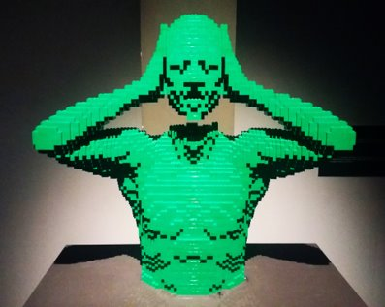
Challenges: learning how to 'do' your subject
Subject lecturers need to engage students in pedagogic situations which explore how we:
think
research
question
argue
work
value
… in [e.g.] Costume and Performance Design
Notes:
Despite A&D context, language is still central (in kind of exchange) where artefacts are 'constructed/represented' through language, not just interpreted.
No deficit model + can't respond to all students specific needs at all times THEREFORE need social model + academic lits approach.
Need to highlight the fact that academic expectations can be hard to understand for students (Laurillard, 2002, Rethinking University Teaching) (especially amongst increasingly diverse cohorts), and so we need to "create pedagogical situations where students can understand, expereience, interpret and react to dsciplinary conventions" (Haggis, 2006, p.530). This is how 'we' think/argue/make/work/value ...
Ideas of independent learning, learner responsibility, 'deep' approach to learning, reflective practitioner are "not neutral truths" of education (Haggis, 2006: 524).
Students need to understand terms like 'analysis', 'argument', 'research', 'critical'.
Lego head image:
Image by <a href="https://pixabay.com/users/ElisaRiva-1348268/?utm_source=link-attribution&amp;utm_medium=referral&amp;utm_campaign=image&amp;utm_content=1982098">ElisaRiva</a> from <a href="https://pixabay.com/?utm_source=link-attribution&amp;utm_medium=referral&amp;utm_campaign=image&amp;utm_content=1982098">Pixabay</a>

Slide 18
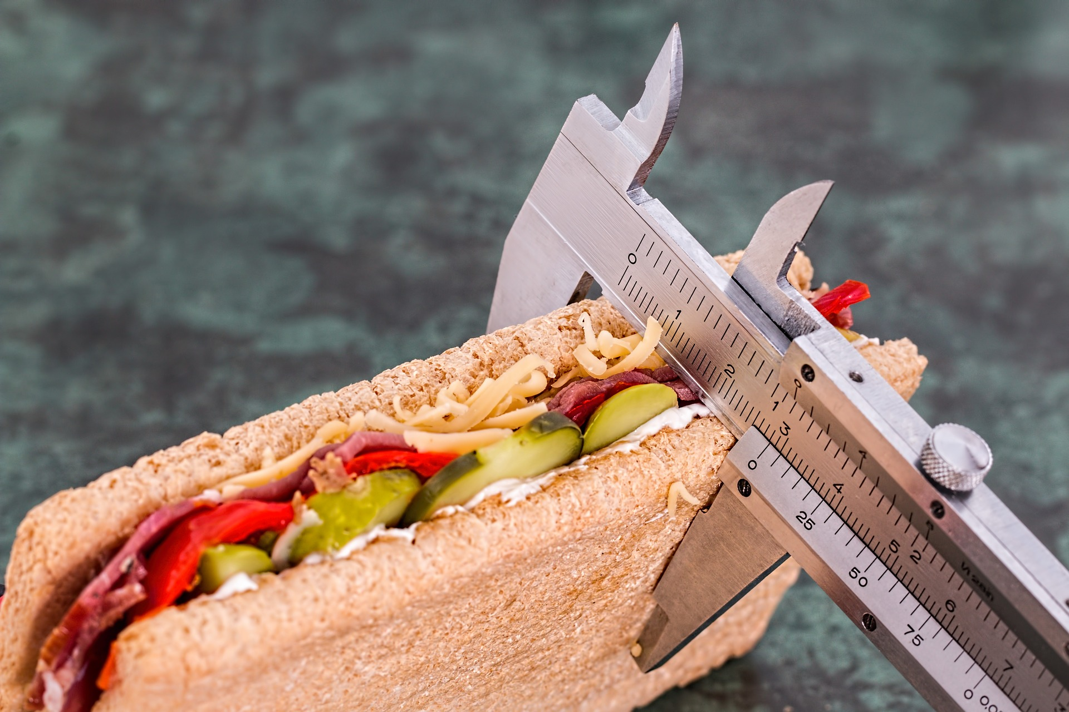
Challenges: standards
There is a concern that "inclusive assessment practices may reduce academic standards and erode educational quality"
(Lawrie et al., 2017: 8)
Notes:
[from Butcher et al., 2010] If asst is: genuinely equivalent in terms of the skills and knowledge they test, all students should be allowed access to these adjustments (Riddell and Weedon, 2006). Lawrie et al. (2017) report that inclusive teaching and assessment can be seen as a "marker of quality". If 'universal design' is followed then "inclusive assessment practices are effective for all students" … but does this really occur – are we justifying our attempts at inclusive assessment by referring to an ideal of inclusivity that we simply don't meet in practice?
How do we measure and evidence parity of effort, challenge, input?
Measure image:
Image by <a href="https://pixabay.com/users/stevepb-282134/?utm_source=link-attribution&amp;utm_medium=referral&amp;utm_campaign=image&amp;utm_content=695723">Steve Buissinne</a> from <a href="https://pixabay.com/?utm_source=link-attribution&amp;utm_medium=referral&amp;utm_campaign=image&amp;utm_content=695723">Pixabay</a>

Slide 19

Challenges: Whole institution approach
Need to understand the disconnect between diverse student populations and their institutions
(Lawrie et al., 2017)
Notes:
Need top down and bottom up change: evidence base, attention to dept contexts, all actors responsible for inclusion, coordinated support and central services [e.g. embedding of academic literacies approach + counselling, wellbeing etc]. (Lawrie et al., 2017)
Need examples of whole-institution approaches (of which we are not one, but are developing it!).
Also need whole-institution CPD support toward inclusion (trying this at AUB via diversity checklist).

Slide 20
AUB: Next Steps
Continue the experiment.
Offer alternative inclusive assessment to ALL students?
Include seminar teaching on presentation skills and methods in collaboration with academic literacies team.
‘First Draft’ presentation feedback (formative).
Consider timetabling implications for assessment.
Consider Parity issues – double marking and equivalence.
Move towards entirely non-written outcomes?
Artwork / exegesis.

Slide 21
TASK 4:
How can you make alternative assessment work at the level of your particular units?

Slide 22
references
Borg, E. (2012). Writing differently in Art and Design: Innovative approaches to writing tasks. In C. Hardy & L. Clughen (Eds.), Writing in the Disciplines: Building Supportive Cultures for Student Writing in UK Higher Education. (pp. 169–187).
Borg, E. (2007). Writing in fine arts and design education in context. Journal of Writing in Creative Practice, 1(1), 85–101.
Butcher, J., Sedgwick, P., & Lazard, L. (2010). Enhancing the Learner Experience in Higher Education (Vol. 2).
Craddock, D., & Mathias, H. (2009). Assessment options in higher education. Assessment & Evaluation in Higher Education, 34(2), 127–140.
Haggis, T. (2006). Pedagogies for diversity: retaining critical challenge amidst fears of ‘dumbing down.’ Studies in Higher Education, 31(5), 521–535.
Harrison, M., Hemingway, L., Sheldon, A., Pawson, R., & Barnes, C. (2009). Evaluation of Provision and Support for Disabled Students in Higher Education Report to HEFCE and HEFCW by the Centre for Disability Studies and School of Sociology and Social Policy at the University of Leeds ii. Retrieved from www.hefce.ac.uk
Hockings, C. (2010). Inclusive learning and teaching in higher education: a synthesis of research. Retrieved from https://www.heacademy.ac.uk/system/files/inclusive_teaching_and_learning_in_he_synthesis_200410_0.pdf
Lawrie, G., Marquis, E., Fuller, E., Newman, T., Qiu, M., Nomikoudis, M., Van Dam, L. (2017). Moving towards inclusive learning and teaching: a synthesis of recent literature. Teaching and Learning Inquiry, 5(1), 1–13.
Waterfield, J., & West B. (2006). Inclusive Assessment in Higher Education: A Resource for Change Staff-Student Partnership for Assessment Change and Evaluation (SPACE). Retrieved from https://www.plymouth.ac.uk/uploads/production/document/path/3/3026/Space_toolkit.pdf
Dr Steven White: swhite@aub.ac.uk
Dr Jon Croose: jcroose@aub.ac.uk

