Slide 1
71 – 17
From Then To Now
Personal reflections on a career spent developing inclusive learning for disabled students
Alan Hurst
(hahurst@yahoo.co.uk)

Slide 2
1971
Challenging the Dominance of the Lecture as the Prime Mode of Learning

Slide 3
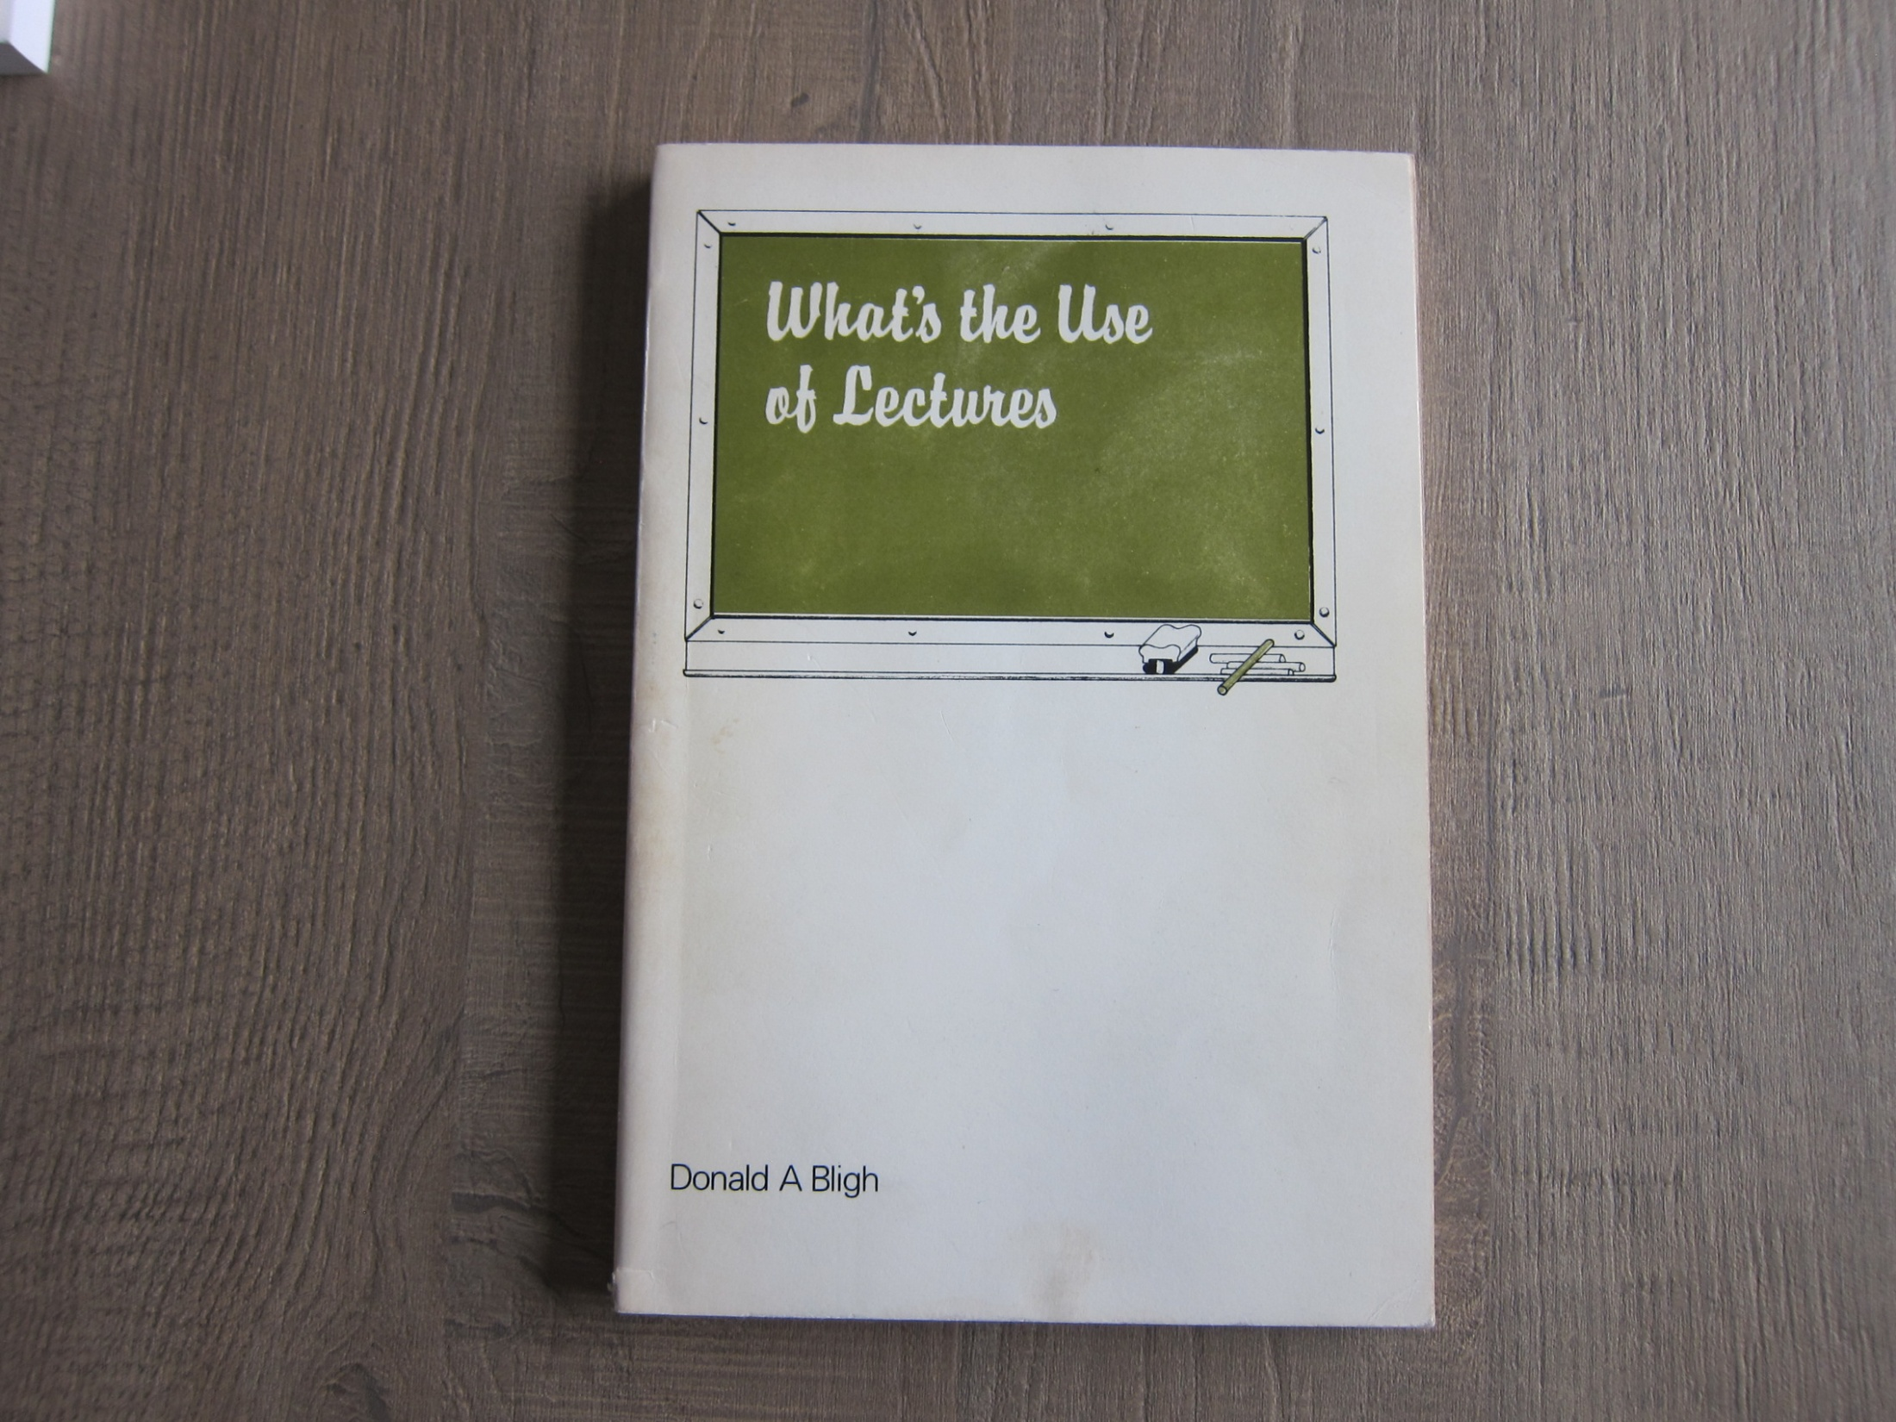
1971
“What’s the Use of Lectures?” Donald Bligh

Slide 4
What’s the Use of Lectures
Donald Bligh
Issue
Attention span – about 20 minutes
Content retention – from first 5 minutes
Solution
Application of some key principles underpinning effective learning – active involvement, variety of task, clear relevance, moving from known to unknown, learning as a fun activity

Slide 5
The 1970s
1974 – “Disabled Students in Higher Education” – published by the National Innovations Centre -a quantitative research study, the first investigation of the topic in the United Kingdom
1976 – the founding of the National Bureau for Handicapped Students which was renamed Skill: National Bureau for Students with Disabilities and which was forced to close in 2011

Slide 6
1990
Challenging the Traditional Approach to Disability

Slide 7
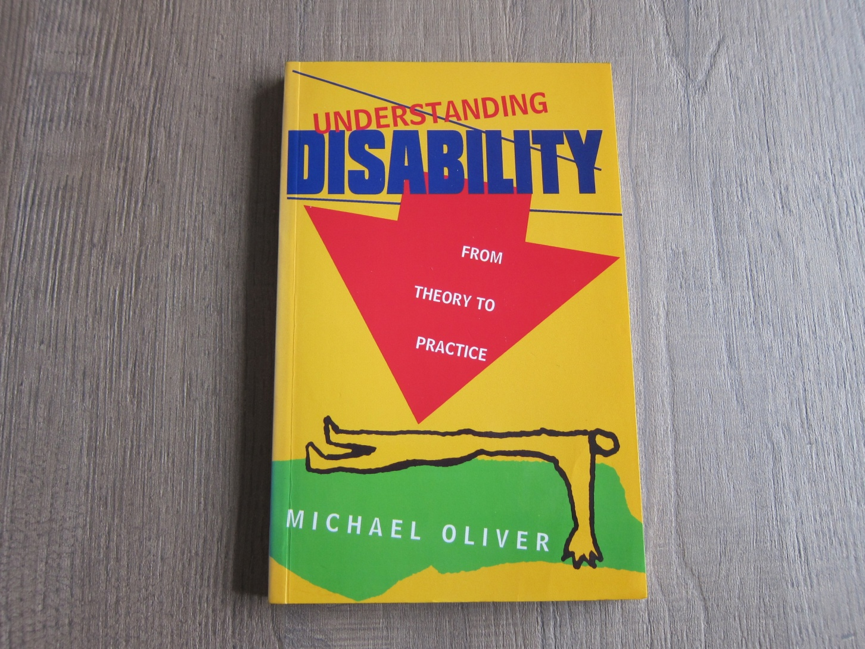

Slide 8
The Politics of Disablement
Michael Oliver
Moving from an individual/medical deficit model of disability
to
A social/political/educational model of disability

Slide 9
Legislative Developments
1992 – the Further and Higher Education Act
Creation of HEFCE, QAA, HEA
1995 – the Disability Discrimination Act
Requirement for reasonable adjustments and the responsibility for anticipatory duties
(although at this time, education not covered by law; DDA revised in 2005 to include education)

Slide 10
Relevant Resources 1999 and later
1999 – HEFCE guidance on base-level provision
1999 – QAA Code of Practice: Section Three Students with Disabilities (subsequently revised then incorporated into the Quality Code
2014 – SLC Non-Medical Helpers Manual
2015 – ECU Competence Standards and Reasonable Adjustments

Slide 11
2000
The first significant indication of the need for attention to be given to the challenges faced by disabled students resulting from curriculum design and pedagogical approaches in the United Kingdom

Slide 12
TEACHABILITY PROJECT
CREATING AN ACCESSIBLE CURRICULUM FOR STUDENTS WITH DISABILITIES
Project funded by the Scottish Higher Education Funding Council
Lead Institution
The University of Strathclyde
Any queries or comments in relation to this publication should be addressed to:
Anne E. Simpson, Project Manager,
Special Needs Service, University of Strathclyde,
Room 4.41 Graham Hills Building.
50 George Street, Glasgow G1 1QE.
Telephone 0141548 3402
Email a.simpson@mis.strath.ac.uk
© Copyright: ThUniversity of Strathclyde 2000
Extracts from this document may be reproduced for education or training purposes on condition that its source is acknowledged.
www.teachability.strath.ac.uk

Slide 13
Course Teaching Staff Asked to:
identify ways in which the subject/course/programme for which you have responsibility or with which you are associated closely is accessible to students with a range of impairments ( i.e. impaired hearing/mobility/vision/intellectual functioning et al)
identify barriers to prevent the participation of students with a range of impairments and if so what are they?
suggest how might these barriers be overcome?
outline what needs to be done in order to implement the strategies you have identified for overcoming the barriers?
say how attention can be drawn in an honest way to the possibilities and challenges posed by our current subjects/courses/programmes of study?
Notes:
13

Slide 14
The “Teachability” Project
Experience in Scotland suggests that sometimes teaching staff need more assistance at the start of the tasks. If this is the case then the key question they need to address is:
What do you consider to be the core requirements/ core skills which all students must have on completing the subject/course/programme of study successfully?
Notes:
14

Slide 15
2006
Marking the Success of the HEFCE Special Initiatives

Slide 16
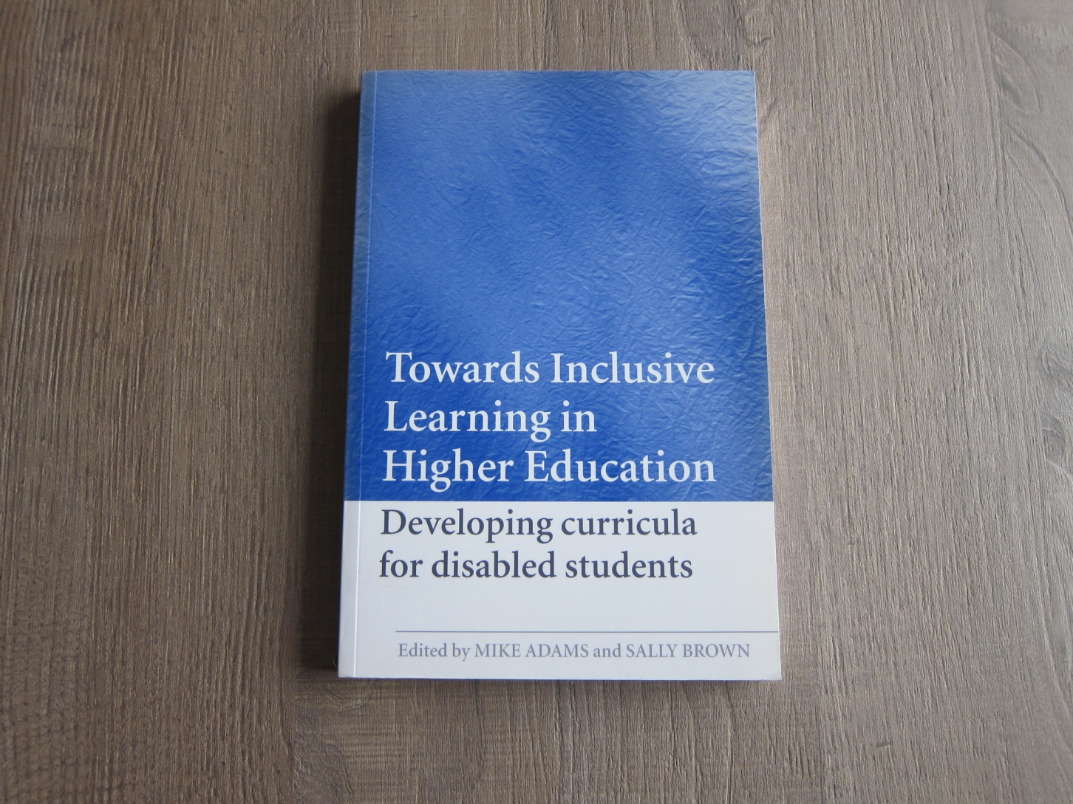

Slide 17
Towards Inclusive Learning in Higher Education: Developing Curricula for Disabled Students
Collection of 15 papers, most stemming from HEFCE-funded “Special Initiative” projects and which included the paper by Hall and Stahl titled ‘Using Universal Design for Learning to expand access to higher education’

Slide 18
2009
The need for research to demonstrate the positive impact and success of inclusive learning

Slide 19
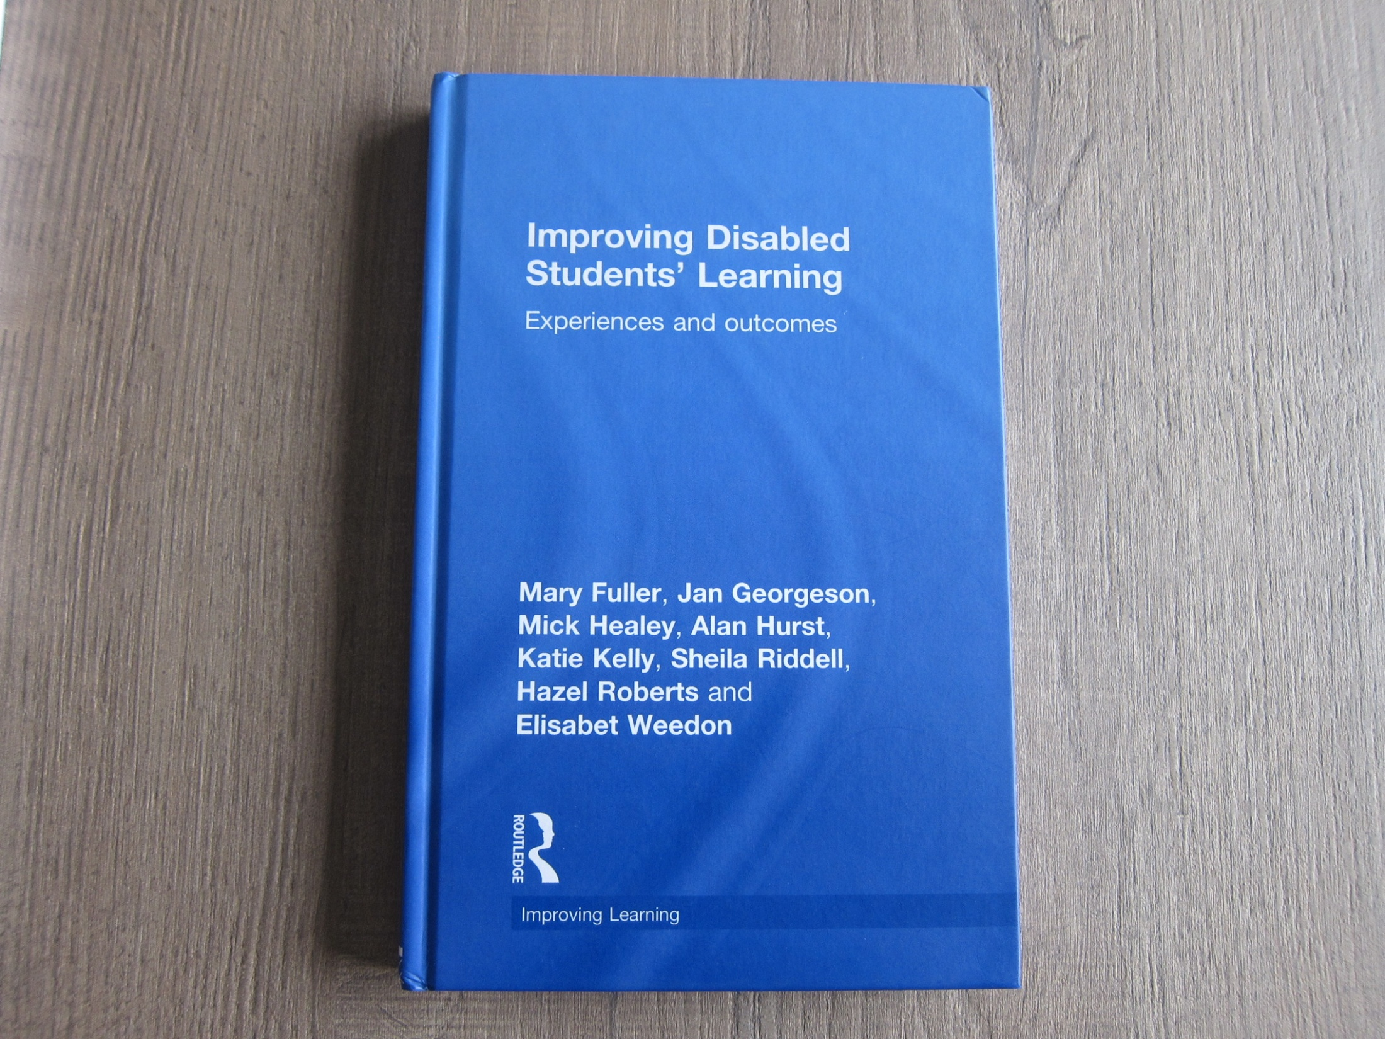

Slide 20
Improving Disabled Students’ Learning
The most recent, comprehensive research study on the experiences of disabled students in higher education in the United Kingdom although it did not explore universal design in any detail

Slide 21
2015
The growing recognition of the value of
universal design of curriculum and of
pedagogy

Slide 22
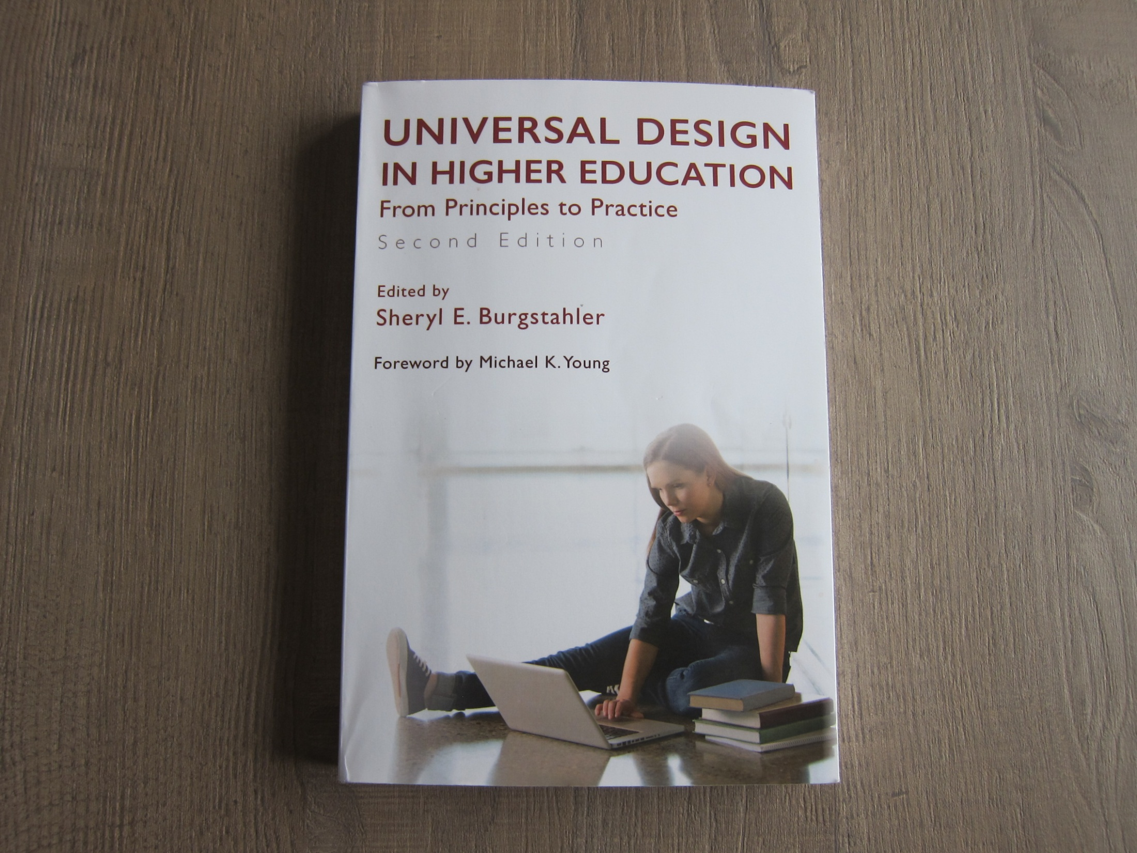

Slide 23
Universal Design in Higher Education: From Principles to Practice
Sheryl Burgstahler
An updated collection of papers outlining how universal design for learning (UDL) has made progress in North America since 2000

Slide 24
2017
Increasing availability of clear, practical, easily-accessed information on how to implement universal design for learning from the USA and –belatedly - from Europe
see the work of David Rose and the Center for Applied Special Technology (CAST) - use Google to find the Center for Universal Design (CUD) at North Carolina State University or start with the university site at www.ncsu.edu
From a huge number of sources look at for example:
ww.ncsu.edu/ncsu/design/cud/about_ud/udprinciplestext.htm and www.udlcenter.org/research/researchevidence.htm
Save time and effort - why “re-invent the wheel”?

Slide 25
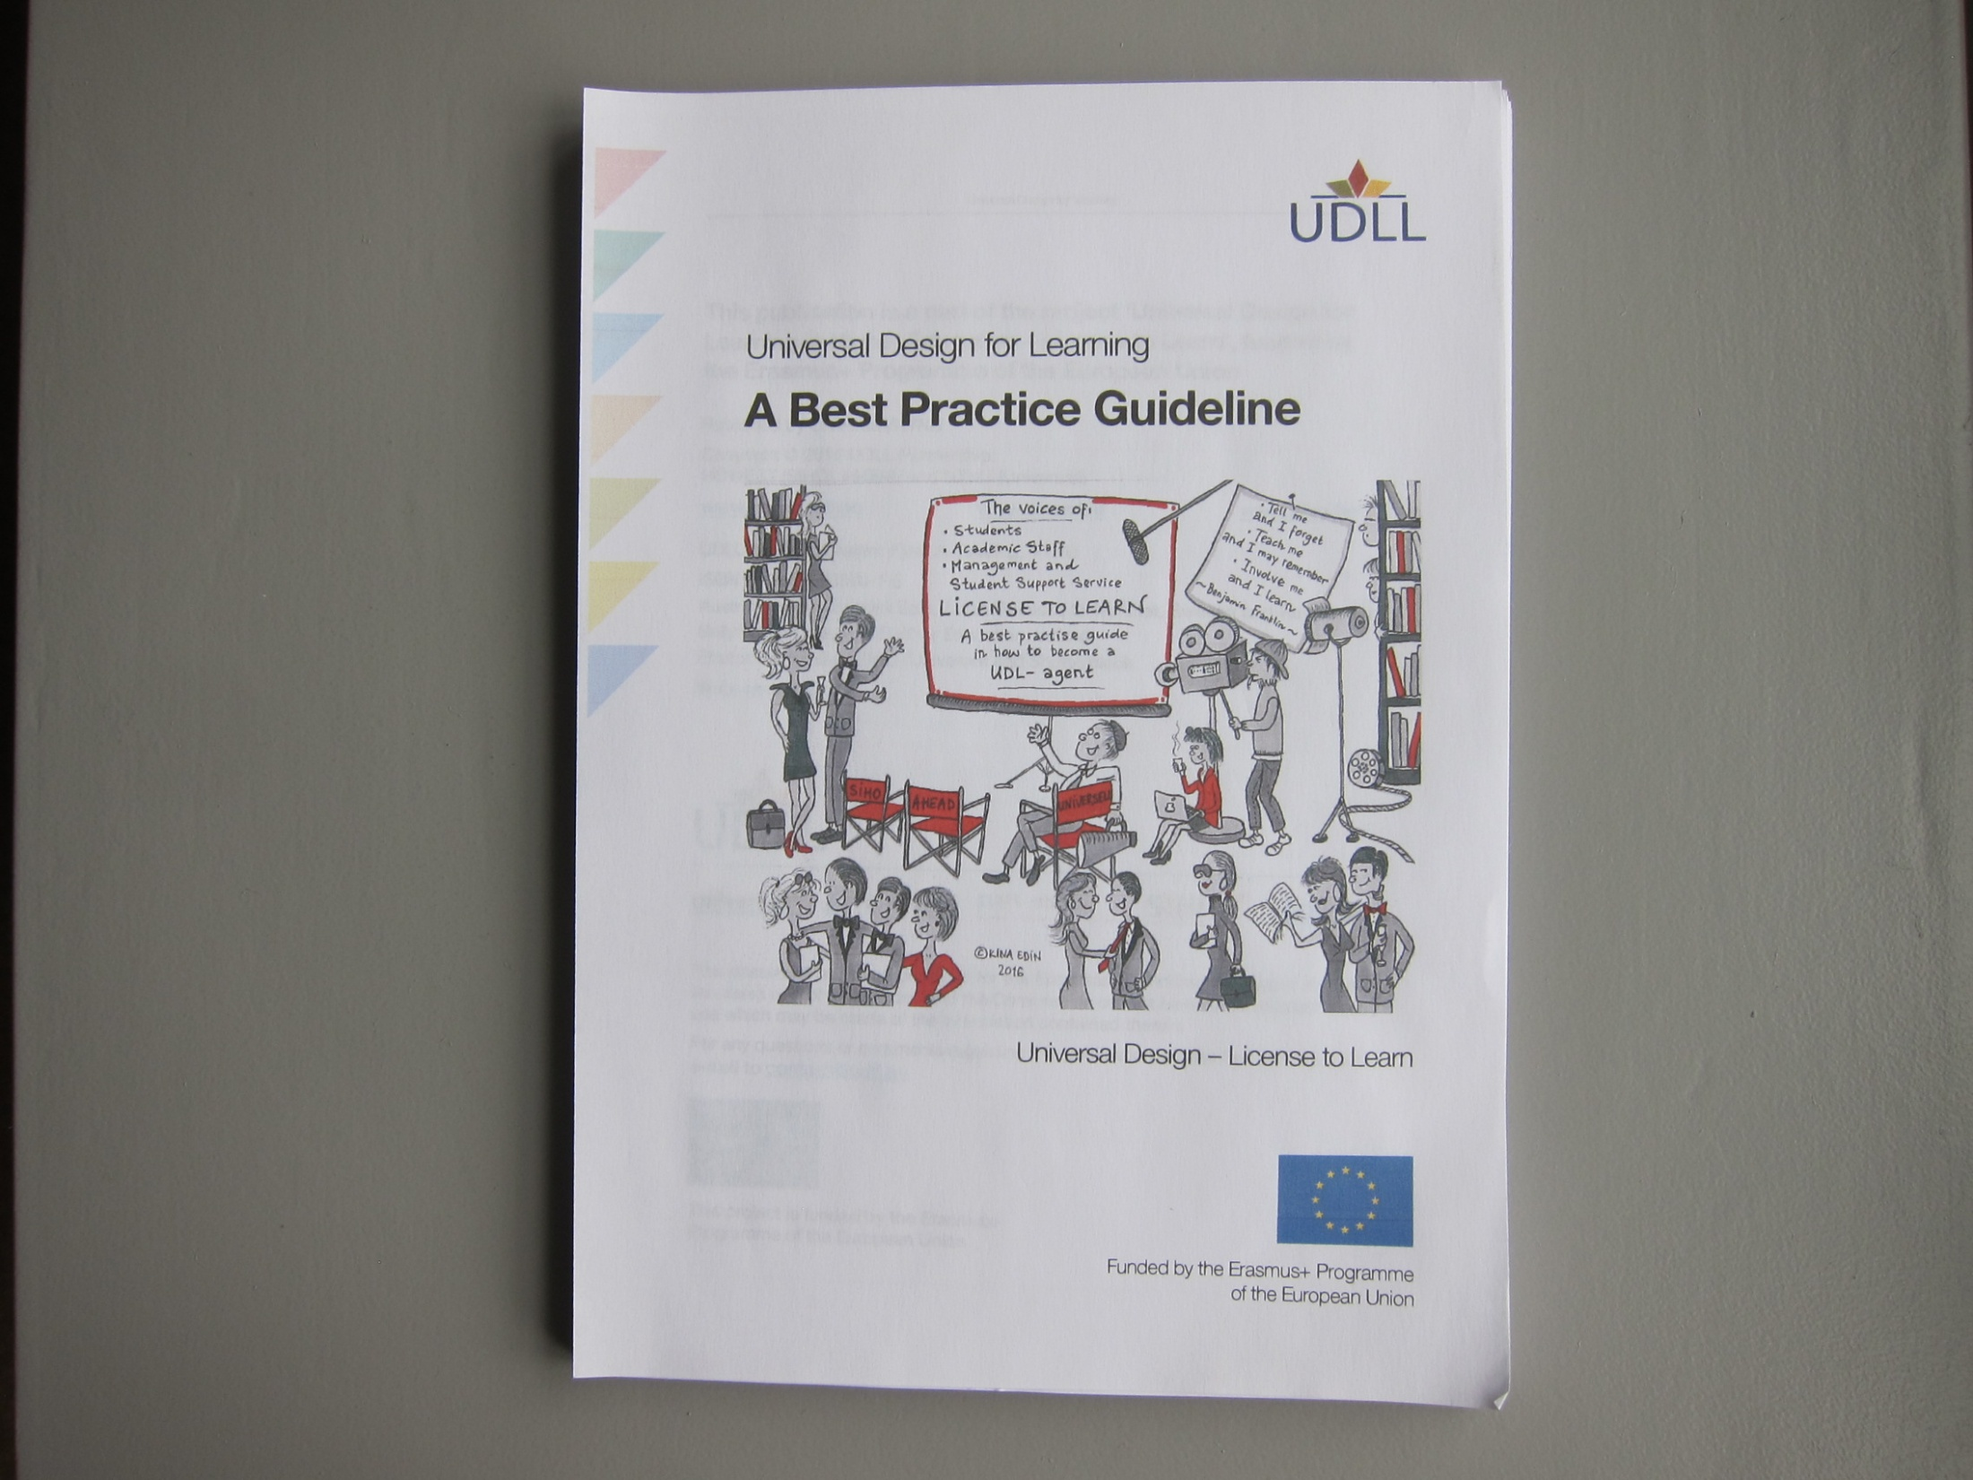

Slide 26
Universal Design for Learning: A Best Practice Guide
The outcome of an EU-funded project led by UNIVERSELL in Norway which contains 80 pages of practical help for those seeking to promote and implement UDL
see https://udlleurope.files.wordpress.com/2016/10/bpg-web-version.pdf

Slide 27
Closing Remarks
Changes to the way support for disabled students are funded since 2015 continues to pose many unanswered and important questions BUT it presents the opportunity to make progress in creating genuine access to many more courses through adopting the UDL approach
71 – 17 a palindrome but are we going to continue going round in circles or will we move forward to secure genuine and full inclusion?
Notes:
Q

Slide 28
Final Comment
“People with disabilities do not wish to ’be included’; they wish it to be acknowledged that they already belong.” (Hastings 1997)

