Slide 1

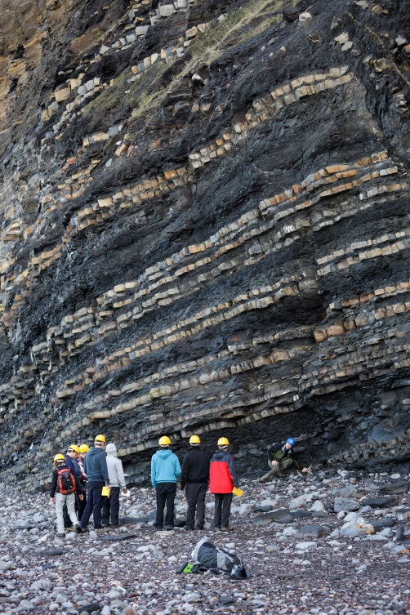
Improving disabled students’ experience of off campus learning activities: a collaborative approach
A shared challenge !
Jane Collings
Educational Developer
Teaching and Learning Support
jane.collings@plymouth.ac.uk
Karen Hocking
Team Lead – Disability Assist
karen.hocking@plymouth.ac.uk

Slide 2

The workshop will explore :
the challenges of off-campus learning activities
the ‘Inclusive student journey from admissions to alumni’.
UoP Reasonable adjustment review panel
UoP off campus processes
Student experience case studies

Slide 3
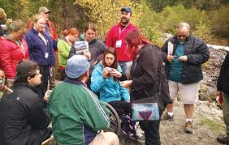
Off Campus activities
What are the challenges?
Reduced DSA support for off campus activities.
Numbers of disabled students @ Plymouth 15.4% (n 3,065)
70% increase @ Plymouth in disclosed mental health challenges in students over the last 12 months.
Academic staff concerns and anxiety over responsibilities for students with wellbeing issues.
Staff increasingly becoming risk adverse around field trips.

Slide 4

Inclusive practice is not new at
Plymouth….
SWANDS Project, Waterfield and West (2002)
SPACE Project, Waterfield and West (2006)
Contingent approach
offers provision of special arrangements or adjustments within existing systems
Alternative approach
offers different assessment methods as a bolt-on for a minority of disabled students.
Inclusive approach
is designed to ensure accessibility for all students and reduces the need for MAPs.

Slide 5

Inclusive student journey
Admissions -realistic (fitness for study/practice issue)
Early identification, communication about students support needs, reasonable adjustments and the Review Panel (RARP).
Consistent & effective personal tutoring
Effective teaching and post session support
Inclusive assessment & feedback
Field trips/off campus activities, laboratory and practical work
Locating and supporting placements
Employment and advice about further study

Slide 6

Reasonable Adjustment Review Panel
The purpose of the panel is to ensure equitable, academically sound and financially viable judgements are made about the levels of additional support funding to be provided for students with disabilities.
The panel will consider and make recommendations on cases where levels of support recommended by a needs assessment would either not be covered by, or would cost more than funding provided by the Disabled Students Allowance ('over and above'), or may be above a level that the University may regard as reasonable.
https://www.plymouth.ac.uk/uploads/production/document/path/6/6586/RARP__terms_of_reference.docx

Slide 7
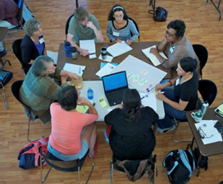
Working Group@ Plymouth : 2016
Academics staff from School of Geography, Earth and Environmental Sciences.(SoGEES)
School administrative staff
Team Lead – Disability Assist
Non- medical helpers
Students
Health & Safety Officer

Slide 8
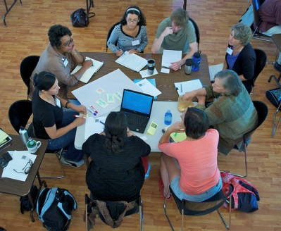
Working Group: Outcomes
Guidance/ template for Schools: Changes to the DSA what you need to know.
Off campus activities procedure
Guidance for staff working with students with specific conditions on field trips
SoGEES requires MHFA on each field trip
https://www.plymouth.ac.uk/student-life/services/learning-gateway/disability-and-dyslexia/field-trips-and-off-campus-learning-activities

Slide 9
Off campus activities – UoP procedure
Identify students with disclosed disabilities and identify any reasonable adjustments.
Staff know how to access a student’s Student Support Document and are familiar with the advice this contains.
Ensure all students complete on-line medical questionnaire.
The trip leader, module lead or personal tutor must meet with students with a disability prior to the activity to discuss their additional support or requirements.
Seek guidance from DAS if necessary; in particular with regard to role and boundaries of any non-medical helper required.(Apply to the RARP for funding if necessary )
Give appropriate consideration to the provision of alternative, equivalent learning experiences for students who can’t participate.
Ensure sufficient First Aiders. A Mental Health First Aider might be necessary after completion of a risk assessment.

Slide 10

Mental Health First Aid Training
4 Mental Health First Aid trainers (MHFA England )
SoGEES require all field trips to have a MHFA (2 day course) .
University of Plymouth guidance states MHFA on field trips is subject to risk assessment
Mental Health Awareness [Lite] training is being rolled out across the university (½ day)

Slide 11
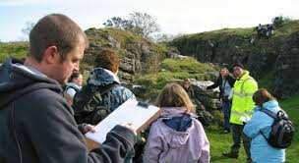
Advise to staff –planning
Consider use of more accessible locations.
Provide detailed information well in advance, using photos and videos to alleviate anxiety. (accommodation, food, travel etc. )
Consider what adaptive or alternative technology could be used.
Encourage students to record outdoor sessions.

Slide 12
Case studies for discussion
Art & Photography student: – Social Anxiety, Borderline personality disorder & PTSD.
Mandatory residential trip to London travelling
by train to visit galleries. (DSA funded 2012)
2. Geology student: - ASD & Social Anxiety.
Mandatory field trip to Spain.
(new student 2016)

Slide 13
Support Provided– 1.
Art & Photography student: – Social Anxiety, borderline personality disorder & PTSD.
Mandatory residential trip to London travelling by train to visit galleries. (DSA funded 2012)
Support worker to travel to London prior to the start of the field trip with the student to conduct familiarisation activities. Support worker to Skype student daily at 6pm to debrief, access to 24 hour telephone advice line.
Support worker to on the return travel to Plymouth.
University funded the daily Skype meeting & advice line

Slide 14
Support Planned-2
2. Geology student: ASD & Social Anxiety.
Mandatory field trip to Spain.( new student 2016)
After discussion with student and staff it was felt the student could cope with academic staff support during the daytime activities.
An application to the RARP for funding was agreed.
A Support Worker to travel with student and support them from 4pm – 10pm each evening.
Clear boundaries agreed for this support

Slide 15
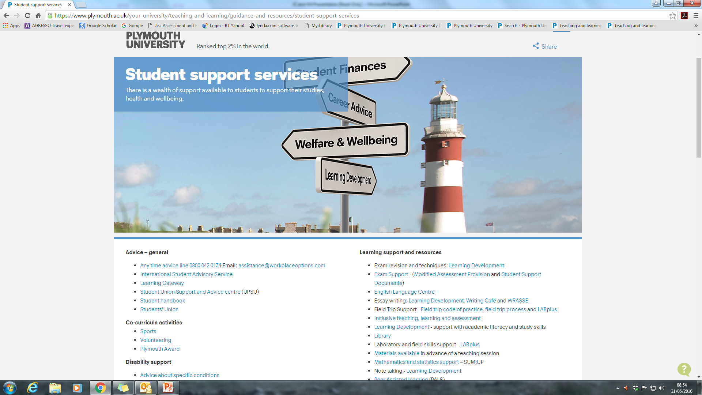
Assisting students and staff to access support services
https://www.plymouth.ac.uk/your-university/teaching-and-learning/guidance-and-resources/student-support-services

Slide 16
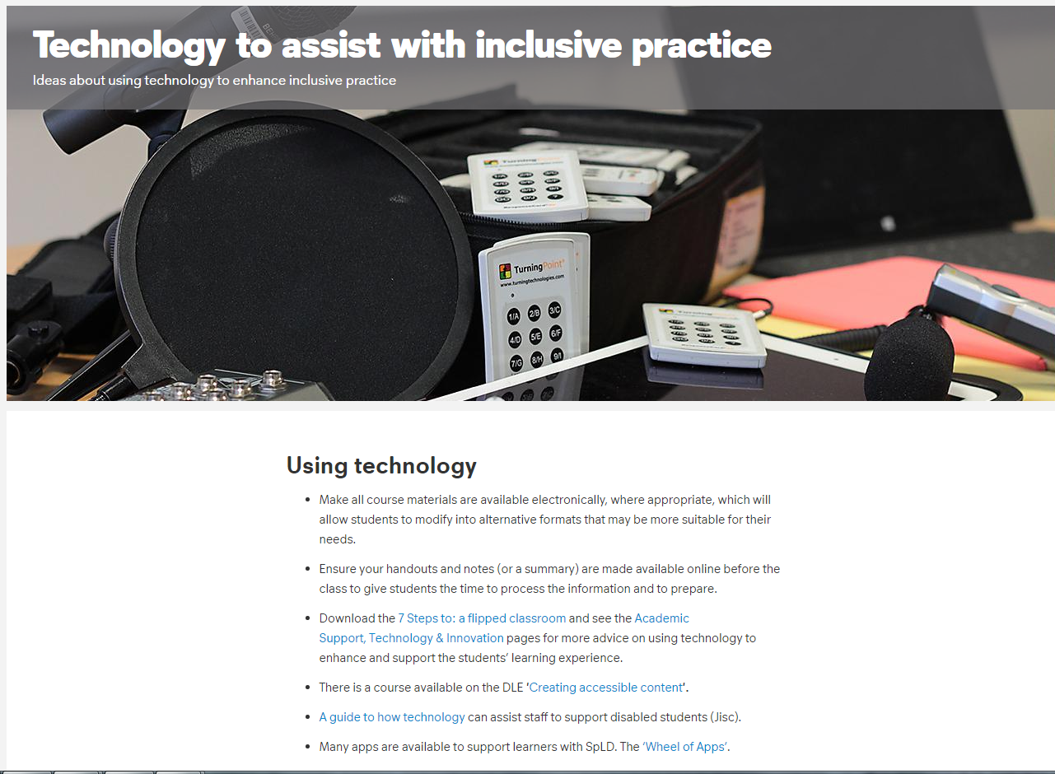
https://www.plymouth.ac.uk/your-university/teaching-and learning/inclusivity/technology-to-assist-with-inclusive-practice

Slide 17
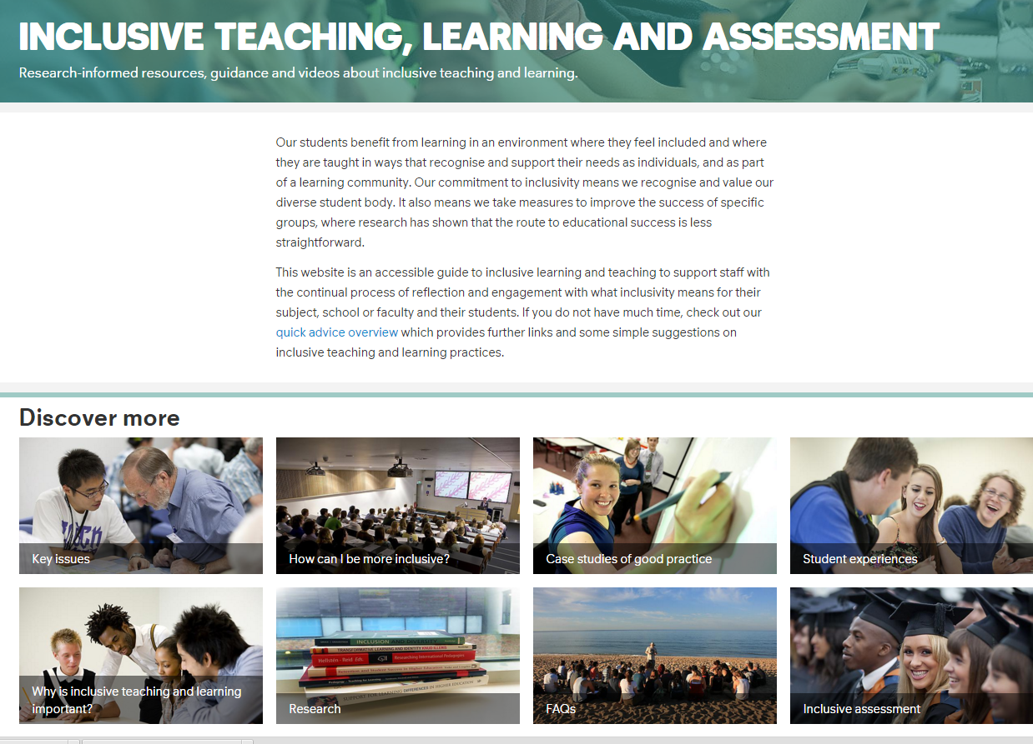
Resources to support staff
https://www.plymouth.ac.uk/your-university/teaching-and-learning/inclusivity

Slide 18
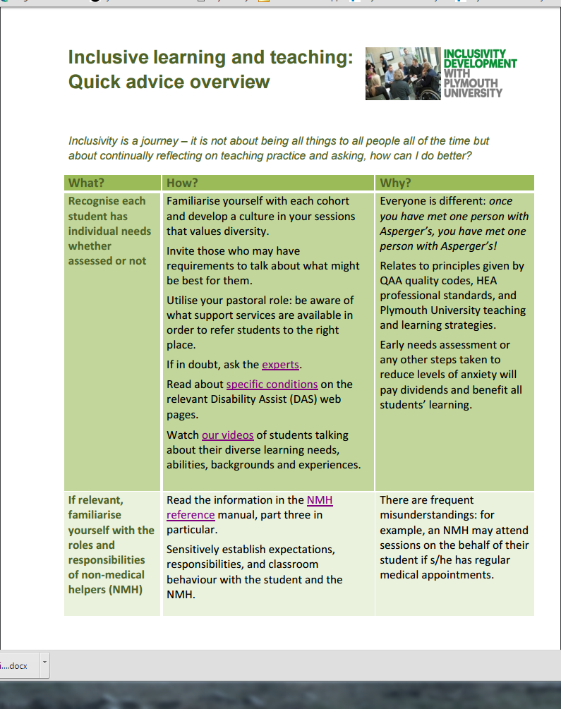
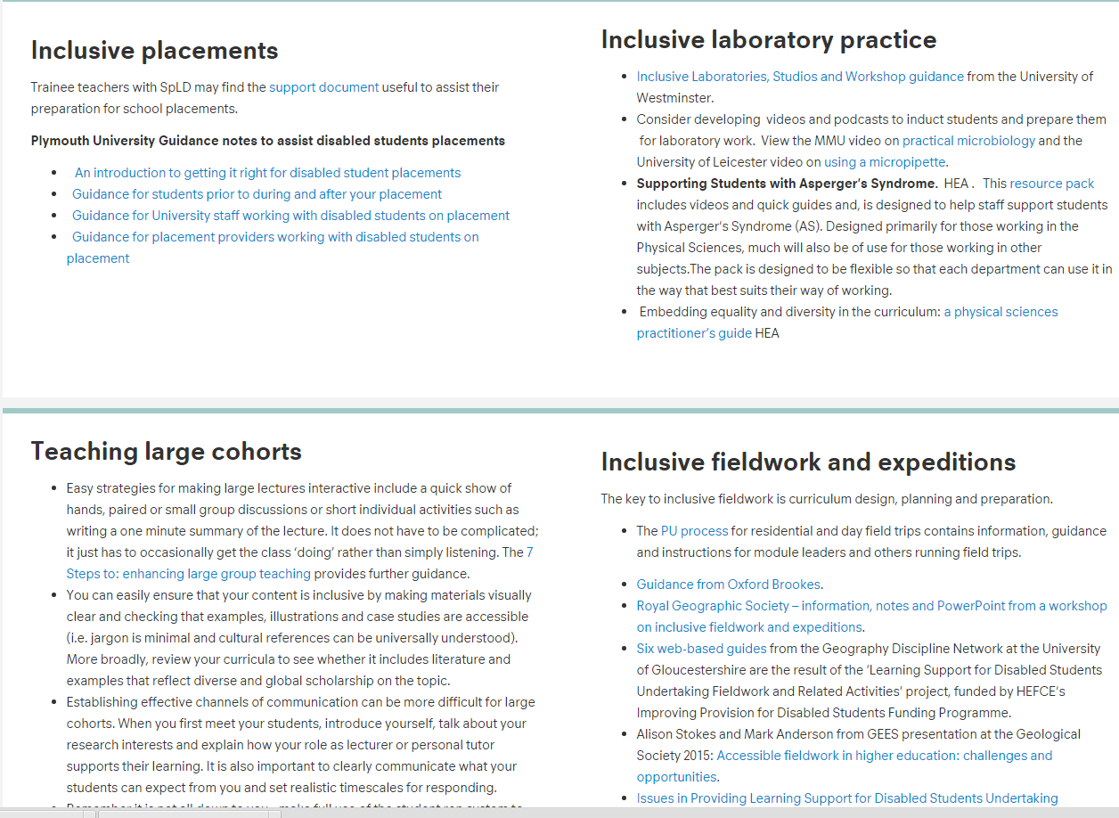
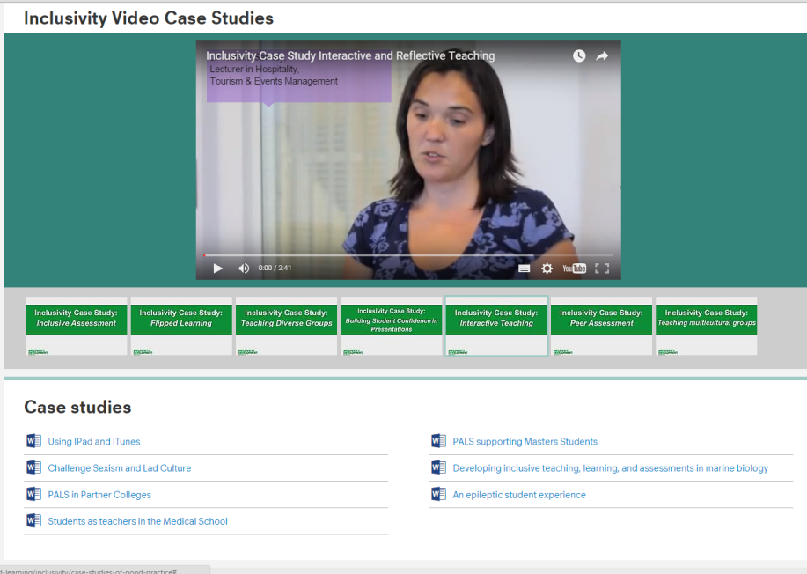
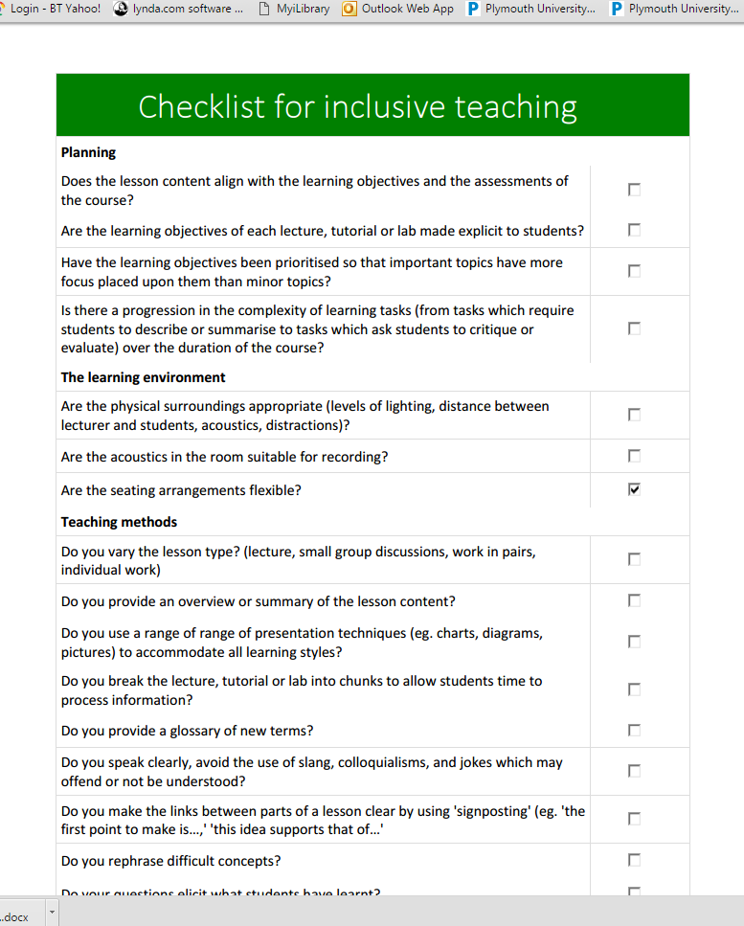
Advice, research & links
Guides &
checklists
Case studies and podcasts

Slide 19
Next Steps @Plymouth
1.Need to further develop admissions, placements and employability
2. ‘Embedding and sustaining inclusive STEM practices’. HEFCE Catalyst fund project (2017-19) Open University, Universities of Leeds and Plymouth.
Embed inclusive resources, module and curriculum design practices. (virtual interactive field & lab work)
Inclusive curriculum delivery practices (practical work & lab work)
Develop inclusive career pathways for students and graduates.

Slide 20
Web resources
Teaching and Learning website: https://www.plymouth.ac.uk/your-university/teaching-and-learning
Disability Assist: https://www.plymouth.ac.uk/student-life/services/learning-gateway/disability-and-dyslexia
Inclusive teaching , learning and assessment: https://www.plymouth.ac.uk/your-university/teaching-and-learning/inclusivity

