Slide 1
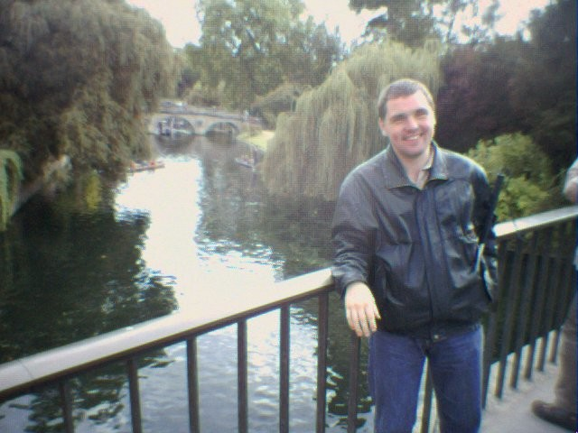
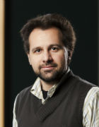
INclusive Practices at KCL
Inclusive Practice in Teaching & Learning
Andreas Konstantinidis
Learning Technologist
Centre for Technology Enhanced Learning
Chris Ross
Inclusive Learning & Teaching Officer
King’s Learning Institute
inclusive.teaching@kcl.ac.uk

Slide 2
Objectives
Inclusive Practices at KCL
explore methods of learning and teaching, that recognise the increasingly diverse context of higher education;
critically reflect upon and evaluate teaching practices in this context;
explore the benefits of diverse student groups and develop techniques to enrich all students’ learning experiences;
engage with key concepts and theories of critical and inclusive academic practice in the context of discipline, institution and higher education;
acquire the skills to deliver multiphasic and effective learning opportunities for diverse students.
apply inclusivity strategies through technological means

Slide 3
Activity
Inclusive Practices at KCL
Reflect on your understanding of:
Inclusiveness
Accessibility
Usability
Think of key-words, synonyms, examples, metaphors…and post these in the Padlet pinboard.

Slide 4
Key moments
Inclusive Practices at KCL
Disabled Student’s allowance
  established by The Department for Education and Skills in 1993
The Disability Discrimination Act: 1995
The Equality Act: 2010
April, 2014
  David Willetts, Minister for Universities and Science, on future changes to Disabled Students’ Allowances (07/04/2014).
September, 2016 - Amendments to DSA support

Slide 5
Withdrawal of non-Medical Helper support
Inclusive Practices at KCL
http://www.disabilityrightsuk.org/government-response-dsa-funding
Practical Support assistant
Library Support assistant
Reader
Sighted Guide
Proof reader
Examination Support Workers
Manual Note takers

Slide 6
Definition of diversity
Inclusive Practices at KCL
The Higher Education Authority (HEA):
“A diverse student body is one which includes individuals of different nationalities, race, creed, colour, religion, sexual orientation, gender, age, disability and socio-economic groupings.”

Slide 7
The reason for Inclusive Education
Inclusive Practices at KCL
Inclusive Education is driven by:
Reduction in Disabled Students’ Allowance
Increased targets for international student recruitment
BME student attainment gap
‘Why is my curriculum white’ student liberation campaigns
Student union representatives’ platforms e.g. on LGBTQ+ issues
Widening participation initiatives

Slide 8
Benefits to Inclusive Education
Inclusive Practices at KCL
There are 4 key areas in which Inclusive Education will benefit universities:
External scrutiny
Equality Act 2010 and Disabled Students’ Allowances (DSAs)
Cost saving
Reputational enhancement

Slide 9
External scrutiny
Inclusive Practices at KCL
It will remediate key issues around differential outcomes for students from different backgrounds.
As a sector, our challenges around disabled, Black and Minority Ethnic (BME), mature, international and Widening Participation (WP) students are all partially addressed by this methodology.
These are core to our successful meeting of Teaching Excellence Framework (TEF) and Quality Assurance Agency for Higher Education (QAA) expectations, and in Access Agreements.

Slide 10
Equality Act 2010 and Disabled Students’ Allowances (DSAs)
Inclusive Practices at KCL
The changes to DSAs expose HE providers to the need to address the full expectations of the Public Sector Equality Duty and Equality Act 2010.
A student who learns inclusively may need no further adjustment to enable them to study effectively.

Slide 11
Cost saving
Inclusive Practices at KCL
Students who thrive are less costly to an HE provider that those who do not.
Inclusive learning is a demonstrably effective tool in enabling students to succeed in study.

Slide 12
Reputational enhancement
Inclusive Practices at KCL
Inclusive practice has the capacity to enhance the standing and reputation of an HE provider in learning and teaching .

Slide 13
Inclusive Teaching
Inclusive Practices at KCL
HE providers could embrace and adopt this approach as it supports and guides the ways in which pedagogy, curricula and assessment are designed and delivered to engage students in learning that is…
meaningful, relevant & accessible to all
It embraces a view of the individual and individual difference as the source of diversity that can enrich the lives and learning of others.

Slide 14
The risk of not being inclusive
Inclusive Practices at KCL
HE providers must create the conditions for all of their students to have the opportunity to succeed.
Through the Teaching Excellence Framework there are measures against which we will all be publicly tested.
These measures, in addition to the legal obligations of the Equality Act 2010, mean that failure to address this issue risks not only reputational damage but also potential financial losses at a time of increased marketization and uncertainty within the sector.

Slide 15
The Endeavour
Inclusive Practices at KCL
Support to enhance staff understanding and leadership on promotion of equality, diversity and inclusive practices.
Using technology as an integral means of promoting inclusive practice and also promoting social inclusion through community engagement and development.
Review our Learning, Teaching and Assessment approaches to identify and address inclusion and equality issues.
Renewed focus on the learner voice

Slide 16
The key barriers that hinder implementation of Inclusive Education
Inclusive Practices at KCL
Leadership from the top of an HE provider
A focus on this area of development in the face of competing priorities
An understanding that culture change is at the root of this methodology.
Engagement with the concept across the University, for example in HR as well as in the classroom
The initial resourcing and project planning to engage in change across the HE provider.
The time to enact change and the embedding of ways to assess success
An understanding that beyond the ‘quick fix’ there is a long process of sustained engagement with this concept as it develops depth and power within an HE provider. Longitudinal focus is required to embed and develop initial work.
Support to engage staff across the HE provider.

Slide 17
Inclusive Education
Inclusive Practices at KCL
“Even though some of us might wish to conceptualize our classrooms as culturally neutral or might choose to ignore the cultural dimensions; students cannot check their sociocultural identities at the door, nor can they instantly transcend their current level of development… Therefore, it is important that the pedagogical strategies we employ in the classroom reflect an understanding of social identity development so that we can anticipate the tensions that might occur in the classroom and be proactive about them.”
(Ambrose et. al., 2010).

Slide 18
Quick actions that can be undertaken
Inclusive Practices at KCL
Housing all teaching materials on the virtual learning environment.
Improve the accessibility of all materials provided.
Ensure reading lists are focussed and up to date
Allow or facilitate the recording of teaching
The use of plain English and clear presentation in lectures
The pre-selection of diverse learning groups
Diversify the range of learning opportunities, approaches and assessment methods
Regarding students as learning partners
The embedding of inclusive practice in recruitment, promotion, performance development review and other staff focussed processes

Slide 19
Inclusive Education at KCL
Inclusive Practices at KCL
Teaching survey
  A survey was conducted across a number of faculties and over 300 responses were received.
  Questions focussed on current practices, resources, methods, knowledge and demands for upskilling and training.
Student data collected from the NSS results and comments from other projects, including the BME Student Success report.

Slide 20
Barriers expressed by students
Inclusive Practices at KCL
No acknowledgement of identity
Little encouragement or guidance on how to interact with peers
Lack of clarity with unfamiliar terminology
A rigid teaching style with no accommodation for different learning approaches
Little effort to obtain personal knowledge, expertise and life experiences from the students
No flexibility with teaching resources
Infrequent signposting to other sources of support

Slide 21
Student comment
Inclusive Practices at KCL
“Our cohort has a range of ages, but many of us have a family with children. The university claim to support mature students but in practice I feel they forget...”

Slide 22
Barriers expressed by teaching staff
Inclusive Practices at KCL
Understanding of inclusive education largely related to ‘accessibility’
78% of survey respondents did not feel confident they had the adequate knowledge or resources to support disabled students in light of the Disabled Students Allowance changes
The (usual) lack of time, resources, and support
Teaching in large group settings
Balancing responsibilities and pressures such as REF
Discipline or programme expectations
Professional programme constraints, e.g. physical disabilities and fitness to practice

Slide 23
KCL Approach
Inclusive Practices at KCL
Collaborative effort across Diversity and Inclusivity (HR) team, Disabled Student Advisory (Student Services) team, Centre for Technology Enhanced Learning
(IT), Study Skills team (Library) and KLI academic staff
Resources on new area of website (Inclusive Teaching portal)
Alignment with KLI’s College-wide Changing Classrooms initiatives (education enhancement)
Alignment with KCL’s engagement with TEF
Central Inclusive Education CPD plus bespoke training for departments, plus a Diversity module on the PGCAP
Supporting Faculty Inclusion strategies where these are being developed.
Support with strategy and policy composition
Audit and tool-kit for measuring inclusivity.

Slide 24
The Inclusive Teaching Portal
Inclusive Practices at KCL
https://internal.kcl.ac.uk/staff/teaching/InclusiveEducation/Index.aspx
Factsheets and guidance on who studies at King’s
Quick guides on Inclusive Teaching
An audit toolkit to gauge Inclusive Practice
Details on CPD opportunities for Inclusive Education
FAQs

Slide 25
The Inclusive Teaching Toolkit
Inclusive Practices at KCL
https://keats.kcl.ac.uk/enrol/index.php?id=38762
A module on the KCL VLE
Encourages reflection on teaching practices
An internal staff resource, which gives us data about staff needs

Slide 26
Activity
Inclusive Practices at KCL
Have a look at the examples of paper based activities.
What accessibility challenges can you foresee?
How can these be overcome?
Post your responses to the forum and respond to the responses of at least one other.

Slide 27
Inclusiveness
Inclusive Practices at KCL
Course Climate
Accessibility
Usability

Slide 28
Course Climate
Inclusive Practices at KCL
Course Climate
Intellectual
Emotional
Physical
Social
Determining factors:
  faculty – student interactions
  student – student interactions
  tone set by instructor
  instances of stereotyping or tokenism
  course demographics (i.e. relative size of racial or other social groups)
  range of perspectives presented in course content

Slide 29
Course Climate
Inclusive Practices at KCL
Explicitly marginalizing
Implicitly centralizing
Explicitly centralizing
Implicitly marginalizing
Hostile
Unwelcoming
Discriminatory
Openly sexist comments
Demeaning attitudes
Indirectly exclude certain groups
Subtle off-putting messages
Responses that validate alternative perspectives
Instructor builds on students’ contributions in a productive and validating way
Marginalized perspectives are intentionally integrated into the content
Inclusion of a variety of opinions
Provisions to foster sensitivity to student perspectives
DeSurra, C., & Church, K.A (1994). Unlocking the classroom closet: Privileging the marginalized voices of gay/lesbian college students. Paper presented at the Annual Meeting of the Speech Communication Association.

Slide 30
Course Climate - Strategies
Inclusive Practices at KCL
make uncertainty safe - validate different viewpoints
resist a single right answer
performance and grading criteria - encourage students to support their opinions with evidence
examine assumptions about students (e.g. background, ability, viewpoint)
do not ask individuals to speak for an entire group
use multiple and diverse examples
establish ground rules for interaction
get feedback on the climate

Slide 31
Activity
Inclusive Practices at KCL
Have a look at the course climate scenarios.
Why did the challenges arise?
How could these challenges have been avoided?
Post your responses to the forum and respond to the responses of at least one other.

Slide 32



Accessibility & Usability
Inclusive Practices at KCL
Usability is the effectiveness of the learning resource
+
=
Accessibility is the path to the learning resource
Learning

Slide 33
Why make resources accessible?
Inclusive Practices at KCL
To not disadvantage students with different capabilities but to provide equal opportunities to all learners.
We need to consider:
How do people access the resources?
  Visually impaired people use assistive technologies like screen readers to read or listen to documents.
  Hearing impaired students will quite often rely on subtitles/captioning, lecture transcripts and even sign language.
When do people access the resources?
  most popular times to access university websites: 11.30am - 13.30pm & 00.00 - 02.00 am
People without disabilities also benefit!

Slide 34
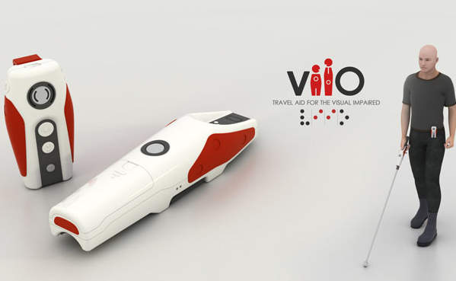

Accessibility – Assistive Technologies
Inclusive Practices at KCL
Video link - screen readers
Impairments
Navigation
Visual
Audio
Cognitive

Slide 35



Usability – Universal Design
Inclusive Practices at KCL
Body
Technology
Universal Design
Time

Slide 36
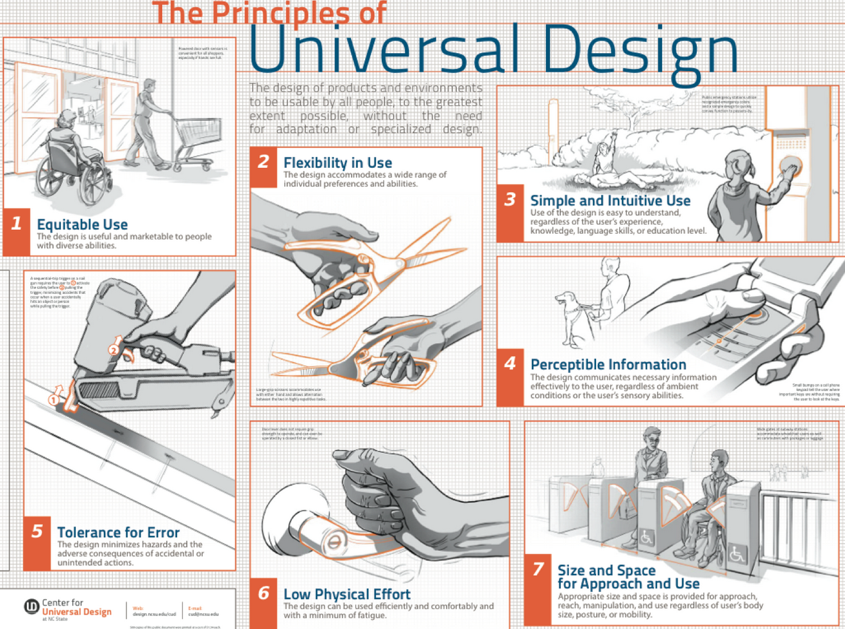
Universal Design – general principles
Inclusive Practices at KCL

Slide 37
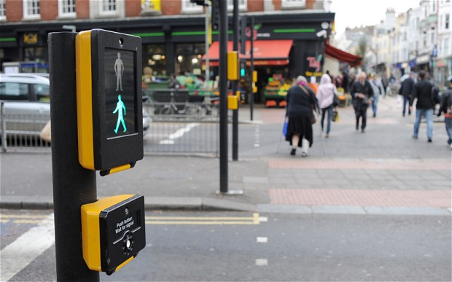
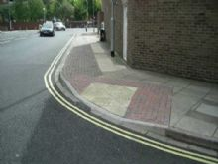
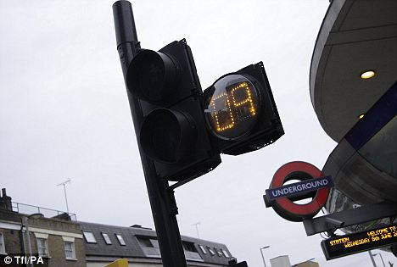
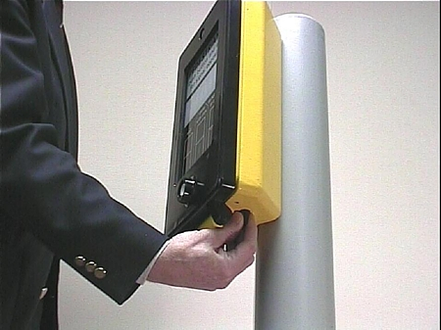
Universal Design - examples
Inclusive Practices at KCL
Can you think of any everyday items that utilize or could benefit from utilizing universal design principles?

Slide 38
Universal Design for Learning
Inclusive Practices at KCL
Principle 1:
Provide multiple means of Representation
WHAT
Perception – sensory difficulties, disabilities, language, cultural differences
Multiple ways to present information: captions, transcripts, audio, video etc.
There is NOT one optimal method of representation

Slide 39
Universal Design for Learning
Inclusive Practices at KCL
Principle 2:
Provide multiple means of Action and Expression
HOW
Refers to how individuals can navigate a learning environment
Different preferences in methods of expression, communication
Allow multiple ways to demonstrate skills and learning
Let them do it their way - multiple ways to complete assignments

Slide 40
Universal Design for Learning
Inclusive Practices at KCL
Principle 3:
Provide multiple means of Engagement
WHY
Methods for increasing motivation and interest: authenticity, autonomy
Opportunities for collaboration or working alone
Good balance of listening vs doing
Set content free – free from the clock, free from format requirement
Self-regulation – e.g. how long would it take to engage with a resource

Slide 41
Best Practice - 1
Inclusive Practices at KCL
Videos, images
  Caption videos, tables, images
  Text inside images is not accessible to screen readers
    Provide alternate descriptions for images, tables
  Provide transcripts for videos
  Use Lecture Capture
Avoid pop-ups and new windows
Make navigation clear and content easy to find
Documents
  Use clear headers and titles
  Use bullet or numbered lists
  Short paragraphs, chapters - chunking
  Utilize alternative illustrations – graphics, images, diagrams
  Avoid detailed web addresses

Slide 42
Best Practice - 2
Inclusive Practices at KCL
Forums
  Clearly establish ground-rules of interaction, etiquette, conventions, expected behaviour and define actions against inappropriate comments
  Encourage profile images, remove anonymity
Presentations
  Add voice narration
  Ensure clear contrast between background and foreground and test on location

Slide 43
Does this mean EXTRA WORK!?
Inclusive Practices at KCL
Not really…
…if you structure you work initially with UDL in mind
…if you make small incremental steps
…if you are assisted by support staff

Slide 44
How to assess accessibility?
Inclusive Practices at KCL
MS Office Accessibility checker
KEATS Accessibility & Screen Reader helper
Inclusive Teaching Online Toolkit & Portal
WAVE - http://wave.webaim.org/

Slide 45
Closing thoughts…
Inclusive Practices at KCL
Where do students get things wrong?
Where do they ask questions?
Where do they ask for alternate descriptions?
Great places for UDL

Slide 46
Additional Resources
Inclusive Practices at KCL
KLI Quick Guides - https://internal.kcl.ac.uk/staff/teaching/QuickGuides.aspx
  7 Steps to inclusive teaching with technology
  7 practitioners’ tips for Teaching in the Context of Diversity
CAST - www.cast.org
3 Play Media - Top 5 Tips for Using UDL in eLearning

Slide 47
Next steps
Inclusive Practices at KCL
Join the Inclusive Education Network
  inclusion@jiscmail.com
Establish a departmental/faculty/institute/sector-wide body of Inclusive Education Champions
Share good practice (e.g. showcasing events and dissemination)
Support with discipline-specific areas for development
Be a platform for advice and guidance

