Slide 1

Building momentum towards inclusive teaching and learning:
A guide to good practice for science and lab-based subjects
Jenni Dyer, Head of Diversity,
Institute of Physics
diversity@iop.org
@iopdiversity, #iopinclusion

Slide 2
The “Building momentum” report is timely because of the changes in the political landscape, i.e. changes to DSA funding and increased pressure to make our universities more inclusive.
It is important because it has the potential to be a catalyst for change across the HE physics sector.

Slide 3
IOP Diversity Programme
During last decade, the Institute has invested over £1m of its own funds to promote a more diverse physics community
Strong track record of publications to share and highlight good practice
Focus has traditionally been on gender equality through our Project Juno
But have looked at other under-represented groups:
  Access for All (2008), guide to the DDA for physics departments
  Instrumental in establishing STEMM Disability Advisory Committee
  Supporting STEM students with dyslexia (2013)

Slide 4
IOP for Inclusion
We have to recognise that there are particular challenges in physics (and science/lab-based subjects)
  wide range of teaching and learning situations - lab sessions, problem classes and fieldwork
  use of mathematical and scientific notation.
Investigated moves towards more inclusive UG teaching and learning and possible barriers
  Identified good practice through 11 visits with physics departments/schools in England
  Ran a survey of IOP disabled student members to find out more about their experiences of studying physics.

Slide 5
Thematic approach
Identified eight themes common across all departments
  Strong and effective leadership
  Clear and consistent policies
  Ongoing training and development
  Encouraging disclosure
  Engagement with central support services
  Communicating student support
  Ensuring adjustments in all assessment conditions
  Lab accessibility and assessment

Slide 6
Strong and effective leadership
Visible commitments to equality and diversity at leadership level
  Need to share learning and practice and adopt anticipatory approaches to reinventing practice
All departments had an E&D Committee
  Need for more embedding of discussions on disabled students and inclusive learning issues
Most had named member of staff responsible for disabled student support
  Need to better capture the expertise of these staff within the department

Slide 7
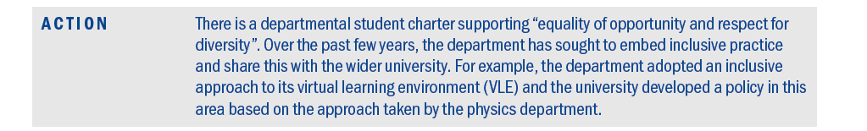
Strong and effective leadership

Slide 8
Clear and consistent policies
All universities were making moves towards inclusive learning policies such as lecture capture
  Need ALL staff to be engaged in this
  Need more understanding the limitations of this in the STEM environment
Embed inclusive learning into review processes
Identify feedback specifically from disabled students in order to improve polices and practice
More training and development needed, but it has to be specific, relevant, targeted and embedded

Slide 9
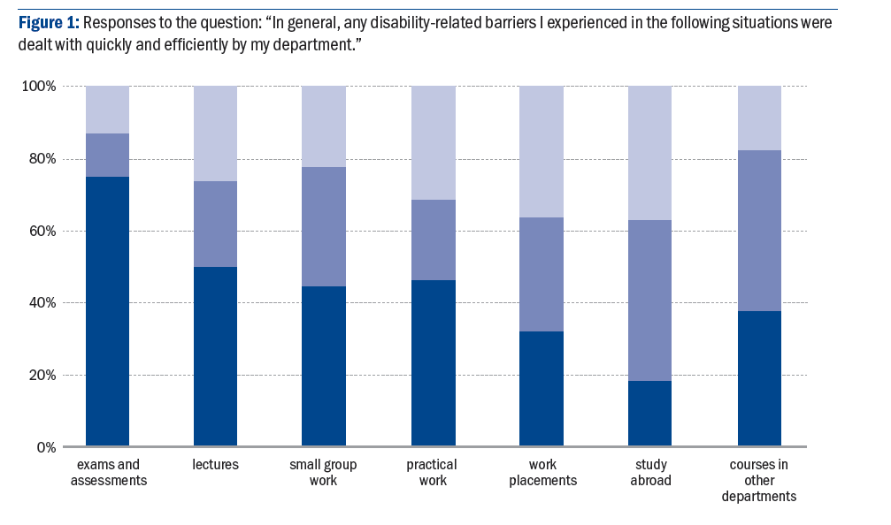
Feedback from students

Slide 10
Encouraging disclosure
89% of respondents had declared their disability to their university:
  47% on applying for the course
  28% on enrolment
  25% became disabled while on their course.
Students with mental-health conditions: least likely to disclose on application, most likely to become disabled
  Departments most concerned about increasing numbers of students with mental health conditions and how to recognise and support them
Need to promote positive culture of disclosure, emphasising the benefits at departmental level
Clear signposting routes on disclosure

Slide 11
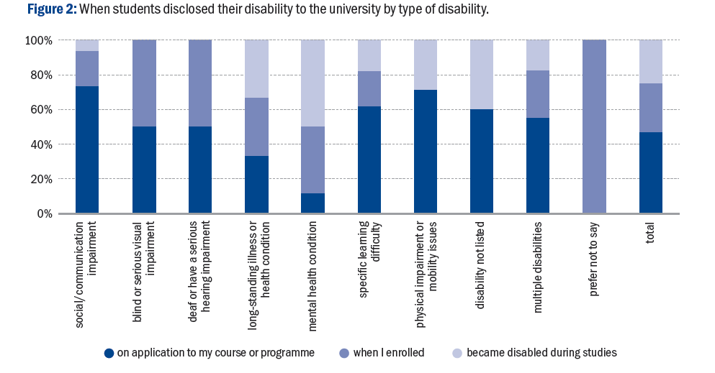
Encouraging disclosure

Slide 12
Student Support Plans
58% of respondents had a document or plan from the disability service
Most likely to cover exams and assessments (84%) and lectures (60%)
Least likely to cover problem-solving tutorials (25%) yet these are a core requirement for a physics degree
Many departments felt the plans were too generic, lacked detail and took too long to process
Departments and disability offices need to work together to create STEM plans
Ensure that everyone involved in teaching and learning understands the plans and how to implement support

Slide 13
Laboratory work
Lab work essential for an accredited physics degree
  Need to talk about degree accreditation!
Most departments managing well on an individual basis
  One or two universities had a STEM lab working group to share practice
  Need to use technology to better effect
  Confusion about how dyslexia sticker schemes operated in the lab environment
  Need to understand core competencies and adjust support plans accordingly

Slide 14
Next Steps
STEM Enable: Collaboration with University of Bath for a new national online resource for accessibility in STEM.
http://stemaccess.referata.com
Logon and find out more!
How can you help with this?

Slide 15
Next Steps
IOP networks to share good practice and support
  Formal support network for those supporting disabled students in physics
  Bringing physicists and accessibility specialists together – what sort of forum would work best?
  Establish an Accessibility Advisory Forum to champion accessibility issues

Slide 16
Next Steps
Engaging with other learned societies
  Addressing STEM-wide barriers
  Shared vision of inclusive learning in physics and the STEM environment
Further research: Postgraduates, staff, others groups
  What do we know about these groups? What research has been done already?

