Slide 1
Bringing the fun back to Statistics Teaching
Inclusive practices to combat statistical anxiety
Zahra Abdulla
Zahra.Abdulla@kcl.ac.uk
@z_abdulla01

Slide 2
The Problem
The reasons why
Sharing my practice

Slide 3
What do you do?
I teach Statistics.
You teach what?
Statistics, like Maths but not.
I was never was any good at Maths at school.
Notes:
Let me introduce you to a conversation I commonly end up having…At this point the conversation ends, and the person makes an excuse to make a quick exit, because people have a preconception of Maths and Statistics teachers – We apparently are very scary people to some. Now imagine 140 students. From varied back grounds, Psychology, Medicine, Nursing etc all with varying experiences in Maths and Statistics.

Slide 4
Statistical anxiety is experienced by as much as
80%
of graduate students
Onwuegbuzie & Wilson (2003)
Notes:
It is estimated that statistical anxiety is experienced by as much as 80% of graduate students and undermines student performance in Research Methods and Statistics teaching. In a group of 140 that is 112 students all bring some kind of preconception about this subject which is causing them some level of anxiety.

Slide 5


The Goal
The Statistically Anxious
The Statistically Harmonious
Notes:
My goal is to help the statistically anxious to transform into the statistically harmonious. But I need to understand what is triggering this anxiety and therefore what strategies can I employ to help them through this challenge.

Slide 6
Six Factors of Statistical Anxiety
worth of statistics,
interpretation anxiety,
test and class anxiety,
Cruise et al (1985)
Notes:
Cruise et al (1985) identifying six factors of statistical anxiety 1) worth of statistics – the perception of the relevance of statistics, 2) interpretation anxiety – anxiety form interpreting statistical output or making decisions from statistical outcomes , 3) test and class anxiety – general anxiety of being present in a statistics class,

Slide 7
Six Factors of Statistical Anxiety
4. computational self-concept,
5. fear of asking for help,
6. fear of statistics teachers
Cruise et al (1985)
Notes:
4) computational self-concept – anxiety when trying to solve mathematical problems, 5) fear of asking for help – anxiety experience from asking their peers or the lecturer for help, and 6) fear of statistics teachers – anxiety about a preconceived notion of the statistics lecturer.

Slide 8

Notes:
The class has 140 students not 112. It is not enough to just tackle one vulnerable group in the class it is important to give all students the opportunity to succeed, to develop and grow, to participate regardless of their starting point, regardless of learning challenges, regardless of anxiety, regardless of ability from those most able to those more challenged in the subject.

Slide 9

Overcoming Anxiety with Inclusiveness
Inclusive pedagogy seeks to accommodate all students in learning
Inclusive pedagogy has been defined as an approach that targets a culture that accommodates all and ensures practice is based on the use of diverse teaching strategies (Corbett, 2001).

Slide 10
Benefits
Evidence has shown inclusive teaching can impact positively on
satisfaction and grades (Oxford Brookes University, 2014),
attendance (Babb & Ross, 2009),
remove barriers to learning (Equality Challenge Unit, 2013) and
can benefit all students not just those with diagnoses such as autism, dyslexia and ADHD (Bhagat & O’Neill, 2011)
save time for teaching staff as an inclusive environment reduces the need for individualised plans (Equality Challenge Unit, 2013).

Slide 11
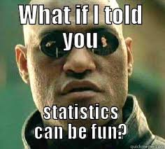
Notes:
What I have learnt from teaching the kids in the bottom set in Secondary school is to not underestimate them, to have the same expectations as I would have for my most able students and for them to engage with Maths after such a traumatic start they needed to enjoy themselves, this is no different whether you are a primary school child or a University graduate.

Slide 12

Creating a safe and calm environment
Music
Facilities
Course Climate

Slide 13
Creating a safe course Climate
make uncertainty safe - validate different viewpoints
resist a single right answer
performance and grading criteria - encourage students to support their opinions with evidence
examine assumptions about students (e.g. background, ability, viewpoint)
do not ask individuals to speak for an entire group
use multiple and diverse examples
establish ground rules for interaction
get feedback on the climate

Slide 14

Personal Connection
Learn their names
Who are they?
What are their backgrounds?
What are they bringing to the teaching experience?

Slide 15

Strong teaching team
  Working with GTAs as teaching partners.

Slide 16
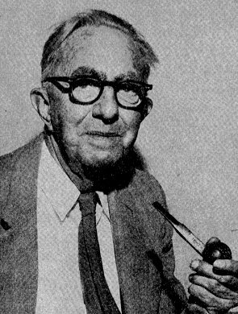
History and context
Frank Wilcoxon
1892 - 1965
Frank Wilcoxon was a chemist and statistician, born to American in County Cork, Ireland. In 1917, he graduated from Pennsylvania Military College with a B.Sc, he was awarded an M.S. in chemistry in 1921 (Rutgers University), and then, a Ph.D. in physical chemistry at Cornell University. He developed an interest in inferential statistics through the study of R. A. Fisher's 1925 text, Statistical Methods for Research Workers.

Slide 17

Peer to Peer learning
Think, Pair, Share
Group work
Notes:
Think-Pair-Share An equity pedagogical best practice to increase and vary student participation within the classroom that was developed by Dr. Frank Lyman in 1981
Consists of 3 tier system that dissects a question introduced by the instructor.
Think-each member silently thinks about question presented.
Pair-Two members are paired to discuss their responses.
Share-Each member may share their response with the class. Think-Pair-Share Strategy provides students with “think time” to reflect and compose their answer.
“Behavioral Rehearsal time” for practicing stating their thoughts without a classmate.
“Student discussion” for practicing speaking and creating class discussions.
Can be used with all learners in any content area.
Group sizes can vary from 2-6 students.
Strategy can be utilized with all diverse learners (Resource, ELL, etc.) because of comfort level with one partner and the ability to practice their ideas
Employing think-pair-share changed the overall climate of the classroom. Improved overall student classroom engagement and supported students understanding of the material. Increased confidence of students with course material. Increased engagement of students has a direct impact on learning outcomes.

Slide 18
Think-Pair-Share
An equity pedagogical best practice to increase and vary student participation within the classroom that was developed by Dr. Frank Lyman in 1981
Consists of 3 tier system that dissects a question introduced by the instructor.
  Think-each member silently thinks about question presented.
  Pair-Two members are paired to discuss their responses.
Share-Each member may share their response with the class.

Slide 19
Benefits
Think-Pair-Share Strategy provides
Students with “think time” to reflect and compose their answer.
“Behavioral Rehearsal time” for practicing stating their thoughts without a classmate.
“Student discussion” for practicing speaking and creating class discussions.
Can be used with all learners in any content area.
Group sizes can vary from 2-6 students.
Strategy can be utilized with all diverse learners (Resource, ELL, etc.) because of comfort level with one partner and the ability to practice their ideas
Employing think-pair-share changed the overall climate of the classroom. Improved overall student classroom engagement and supported students understanding of the material. Increased confidence of students with course material. Increased engagement of students has a direct impact on learning outcomes.

Slide 20
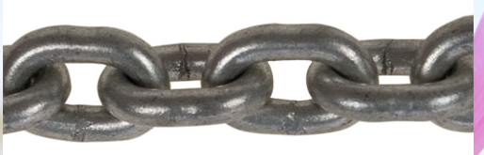
Constructive Alignment
Constructive alignment is the underpinning concept behind the current requirements for programme specification, declarations of Learning Outcomes (LOs) and assessment criteria, and the use of criterion based assessment.
Activities
Learning Outcomes
The 'constructive' aspect refers to the idea that students construct meaning through relevant learning activities rather than from the teacher imparting knowledge to the learner.
The 'alignment' aspect refers to what the teacher does, which is to set up a learning environment that supports the learning activities appropriate to achieving the desired learning outcomes. The key is that the components in the teaching system, especially the teaching methods used and the assessment tasks, are aligned with the learning activities assumed in the intended outcomes.

Slide 21
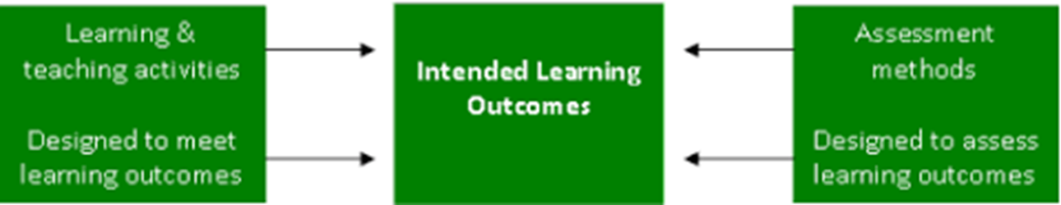

Constructive Alignment (Biggs and Tang, 2011)
21
Assessing students’ actual learning outcomes to see how well they match what was intended
Define the learning outcomes (LOs)
Design assessment methods/criteria to assess the LOs
Select learning/teaching activities that will enable students to attain the LOs
Assess how well students have met the LOs according to the assessment criteria already devised
Note: 3 can come before 2 (is actually what Biggs intended)

Slide 22
Constructive Alignment in Practice
Consider the module descriptions you teach on in relation to how constructively aligned they are
Evaluate if the learning outcomes are aligned with the assessment:
If they are, how and why are they?
If they are not, why not and how might better alignment be achieved?

Slide 23
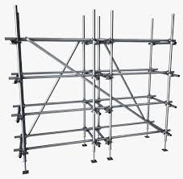

Notes:
Scaffolding statistical problems
Teaching Statistics in a context they can understand

Slide 24
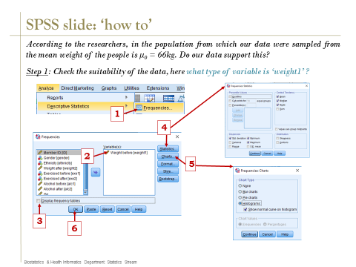
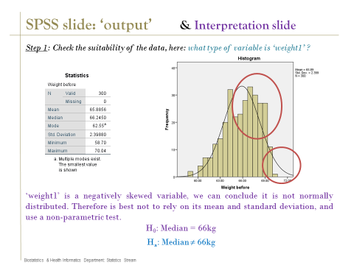
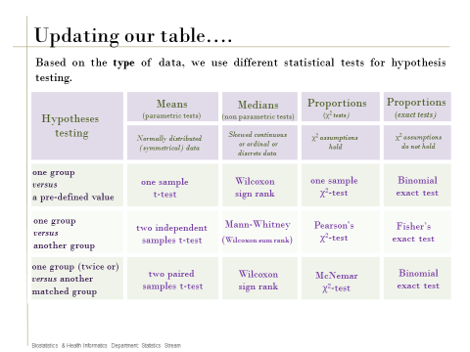

Slide 25
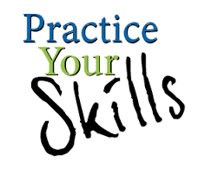



In Class Practical's
Lecture Progress Quizs (MCQs)
Practical Progress Quizs
Notes:
Design for interactivity
Using different language
Plenty of time to practice their skills in a supportive environment
Curriculum activities aligned with the final assessment
Opportunities to practice independently
Opportunities to be part of the learning process

Slide 26
Multiple Choice Questions (MCQs)
Multiple choice is a form of assessment in which respondents are asked to select the best possible answer (or answers) out of the choices from a list
Although E. L. Thorndike developed an early multiple choice test, Frederick J. Kelly was the first to use such items as part of a large scale assessment.
If guessing an answer, there's usually a 25 percent chance of getting it correct on a 4 answer choice question.
Finding the right answer from multiple choices can be automated using multiple choice question answering systems.

Slide 27
Considerations when creating MCQs Pedagogical
Assessment for Learning Principles
Good practice
Engages students with the assessment criteria
Supports personalised learning
Ensures feedback leads to improvement
Focuses on student development
Stimulates dialogue
Considers student and staff effort
encourages contact between students and lecturers
develops reciprocity and cooperation among students
encourages active learning
gives prompt feedback
emphasises time on task
communicates high expectations
respects diverse talents
(Chickering and Gamson,1987)

Slide 28
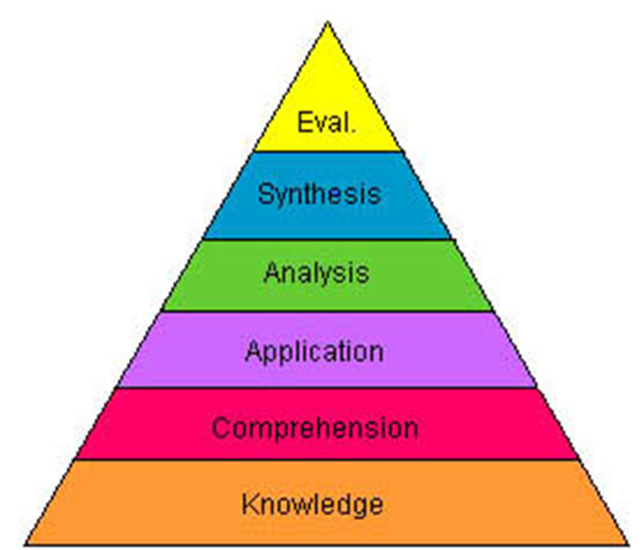
Considerations when creating MCQs
Bloom’s most quoted domain – the cognitive

Slide 29
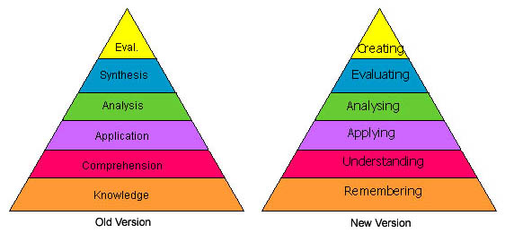


Revised by Anderson in the 1990’s
Nouns to verbs and the top two reversed

Slide 30
Reflection and Goal Building
How challenging did you find the progress quiz?
What did you learn from the Reading Activity?
What did you learn from the Progress Quiz?
How much time did you spend Thinking, looking back at your notes/practical, using SPSS, documenting your findings?
What do you wish you knew before starting the progress quiz?
What would you like to explore further?
Identify one learning goal you hope to achieve before next week

Slide 31




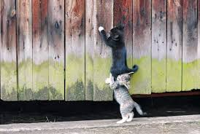


Bringing ‘You’ to Teaching
Notes:
To show my enthusiasm and have fun,
To be supportive,
To be honest,
To own up to mistakes –we all make them but its learning from them that counts,
To bring your own research and experience to teaching,
To catch the students who are falling through the net, follow up on attendance, be consistent and organised
And last but by all means not least – well you can’t be a statistician if your not just a little crazy ☺

Slide 32
Amazed to admit it, but I've enjoyed learning statistics!
I think I got stats for the first time in my entire life
Loved the interactive approach, didn't feel overly pressuring
The teacher in very nice and enthusiastic!
It was good being able to go over and practice what you had learnt
The TA’s were very helpful
All the support helped calm my stats anxiety because I never felt completely out of my depth.
Very Interactive
Notes:
Some students comments.

Slide 33

Thank you for listening.
Any questions?
Zahra.Abdulla@kcl.ac.uk
@z_abdulla01

