Slide 1

Inclusive Teaching & Learning:
What’s your ‘why’?
UKIPN Network Event
13 December 2017
University of Wolverhampton

Slide 2

What is Inclusive Teaching?
‘inclusive learning and teaching recognises all student’s entitlement to a learning experience that respects diversity, enables participation, removes barriers and anticipates and considers a variety of learning needs and preferences’.

Slide 3
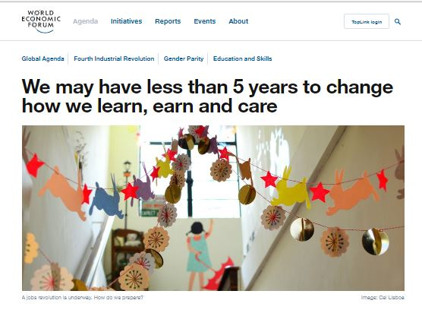

Why inclusive, why now?

Slide 4
Key global challenges
Globalization and technology are accelerating job creation and job destruction
Studies suggest 65% of children currently entering primary school will have jobs that do not yet exist …their education will fail to prepare them, exacerbating skills gaps and unemployment in the future.
Underdeveloped adult training and skilling systems unable to support learning for currently active workforce of nearly 3 billion people.

Slide 5
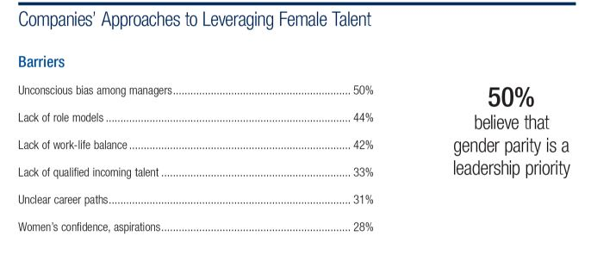
Global Challenges cont…
Despite women’s leap forward in education, their participation in the paid workforce remains low; current forecasts for economic parity [current progress] = c. 170 years.

Slide 6
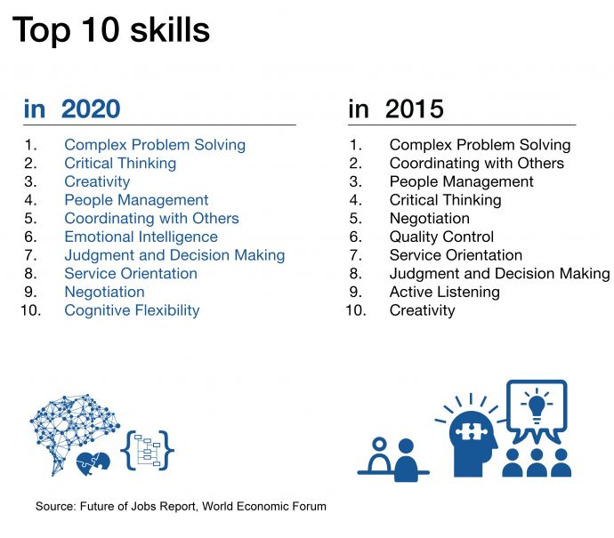
New skills needed

Slide 7
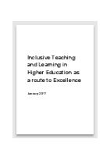
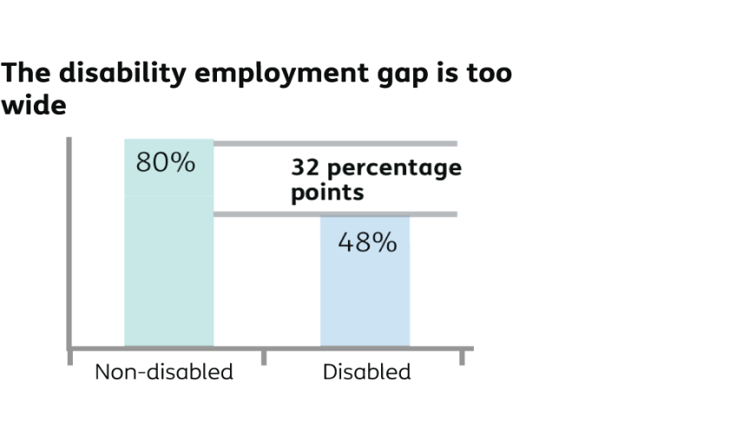
UK context for Inclusive L&T
Cost of Disabled Students Allowances
Equality Act 2010
Lack of progress on #inclusion
(previous initiatives ad infinitum)
Continued degree attainment gap (disabled vs non-disabled)
Underemployment of
Disabled graduates

Slide 8
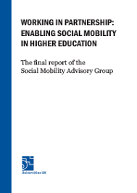
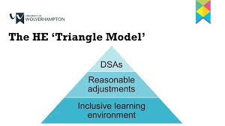
UUK SMAG / DSSLG
SMAG (2015) ‘practical ways to address
inequality in Higher Education’.
DSSLG published guidance in Jan 2017 citing
4 key benefits of inclusive practice :
  External Scrutiny [TEF, QAA, OFFA~ OFS]
  EA 2010 and ‘modernisation’ of DSA
  Cost Saving
  Reputational Enhancement

Slide 9
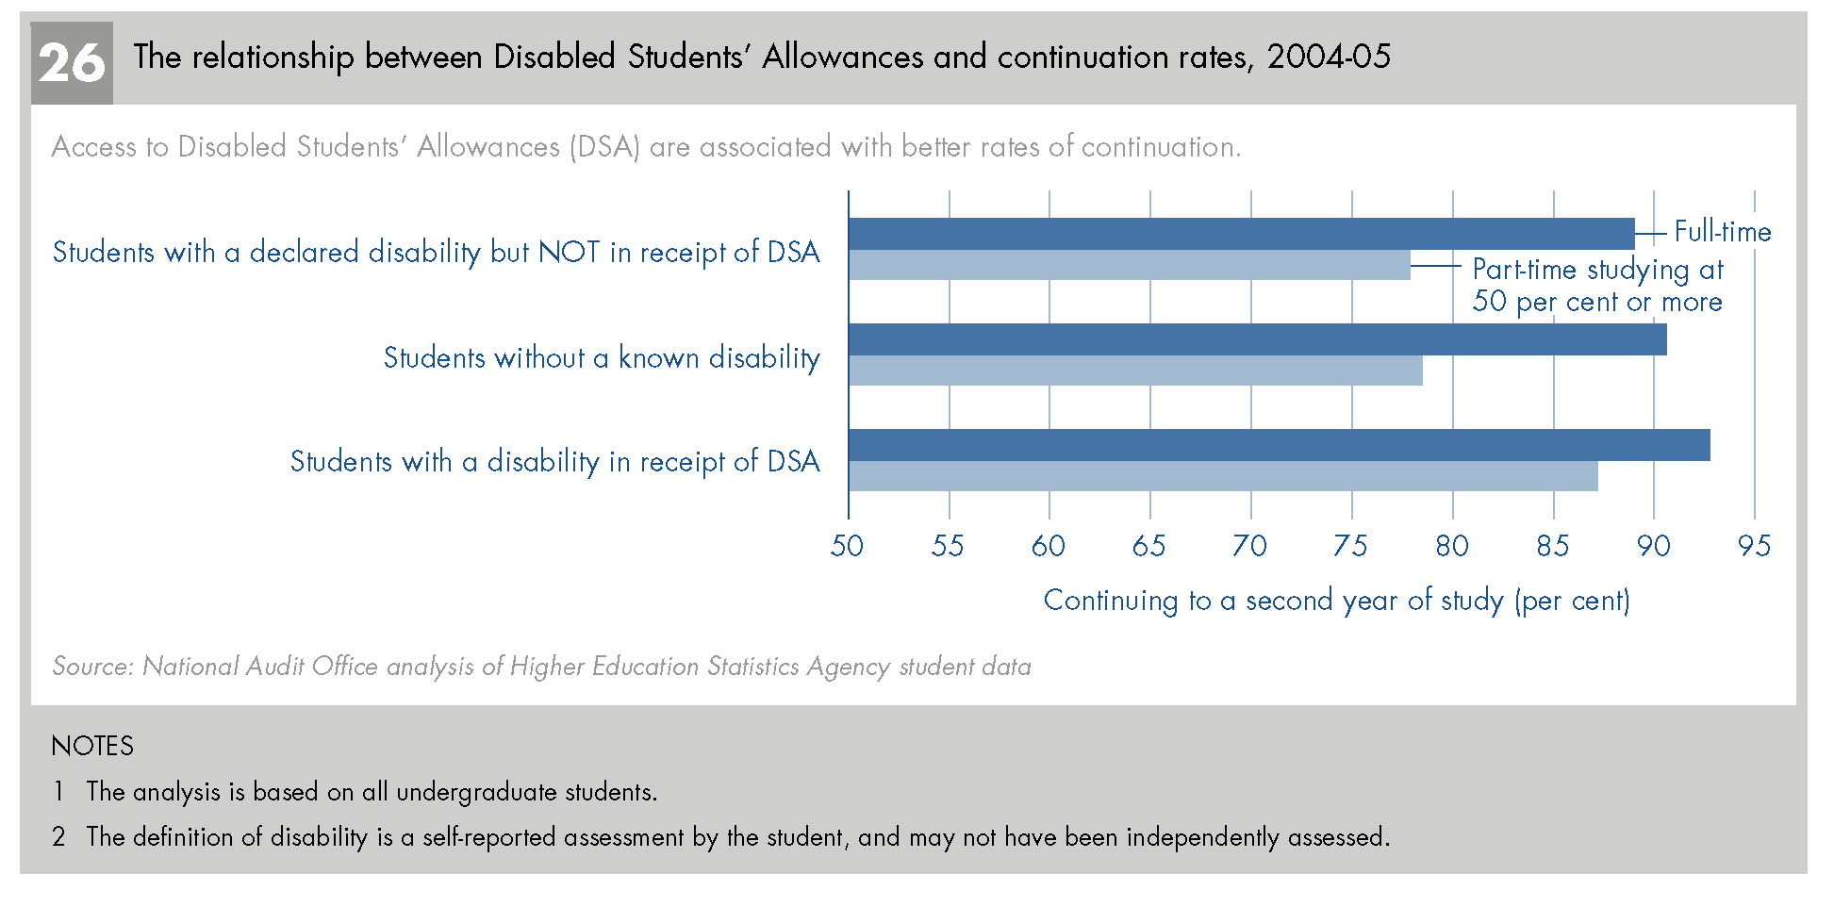
10 Whys…
1: DSA Retention

Slide 10

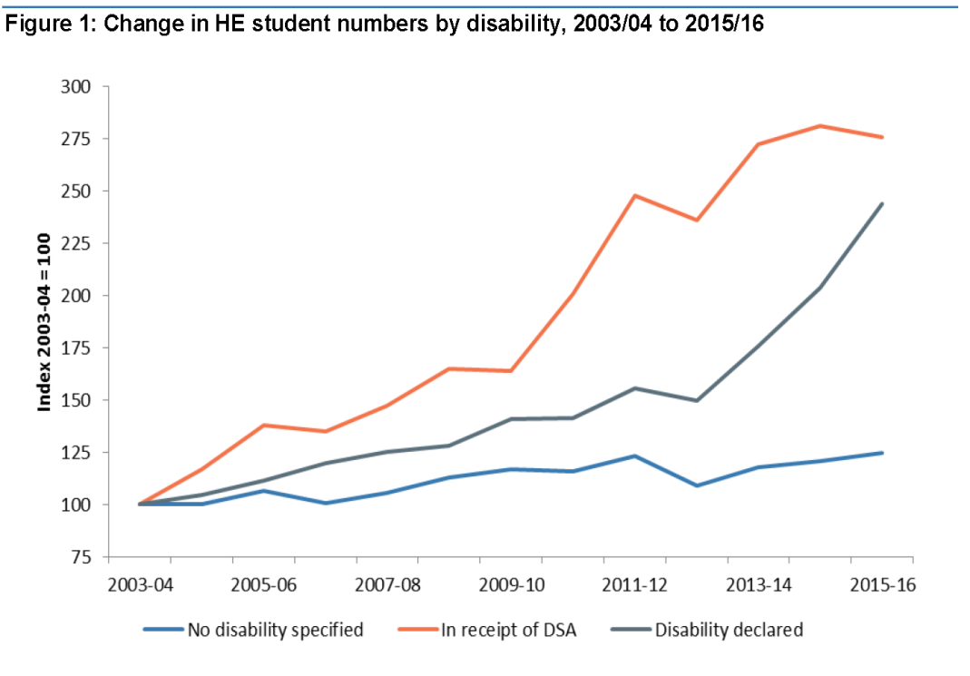
2 DSA: RIP?
DSA rose to £125M in 11/12 from £91.7 08/09
HEFCE funding £13.2M in 11/12

Slide 11
3 Social model of disability
capabilities instead of deficits
what works not what’s missing

Slide 12

4. Legislative duty
EHRC £50k Legal Support Project
for discrimination in education

Slide 13
5. The Government says so!

Slide 14
Inverting the pyramid – reasonable adjustment involves
Current position
Future position
Inclusive provision
Support services
DSA
DSA
Support services
Inclusive provision

Slide 15
Inclusion involves all these things working hand in hand
Excellence in teaching, learning and assessment practice
Support Services
DSA
INCLUSION

Slide 16

6. Research Evidence
  Disabled students say so:
    11% of the disabled learners surveyed said that academic assessments did not cater for their needs compared to 4% of non-disabled learners
    (Vickerman & Blundell, 2010)

Slide 17
6. Research Evidence cont
  Teaching staff say:
    “I think there are problems with money and I don’t think it’s the school, I think we need more money, and this idea of inclusion has to be understood to be more than window dressing” Paliokosta & Blandford (2010)

Slide 18
6 Research Evidence cont+
  Teaching staff say:
    ‘Time was another recurring theme. In the English
    department, this was linked to there being too much to cover in the curriculum to give time to meeting individual needs.’
    Ellins & Porter (2005)

Slide 19
7. Joining up education ~ pre-uni inclusion initiatives well underway
EHCPs in schools

Slide 20
8. Benefits ALL students (not just disabled students or BAME)

Slide 21
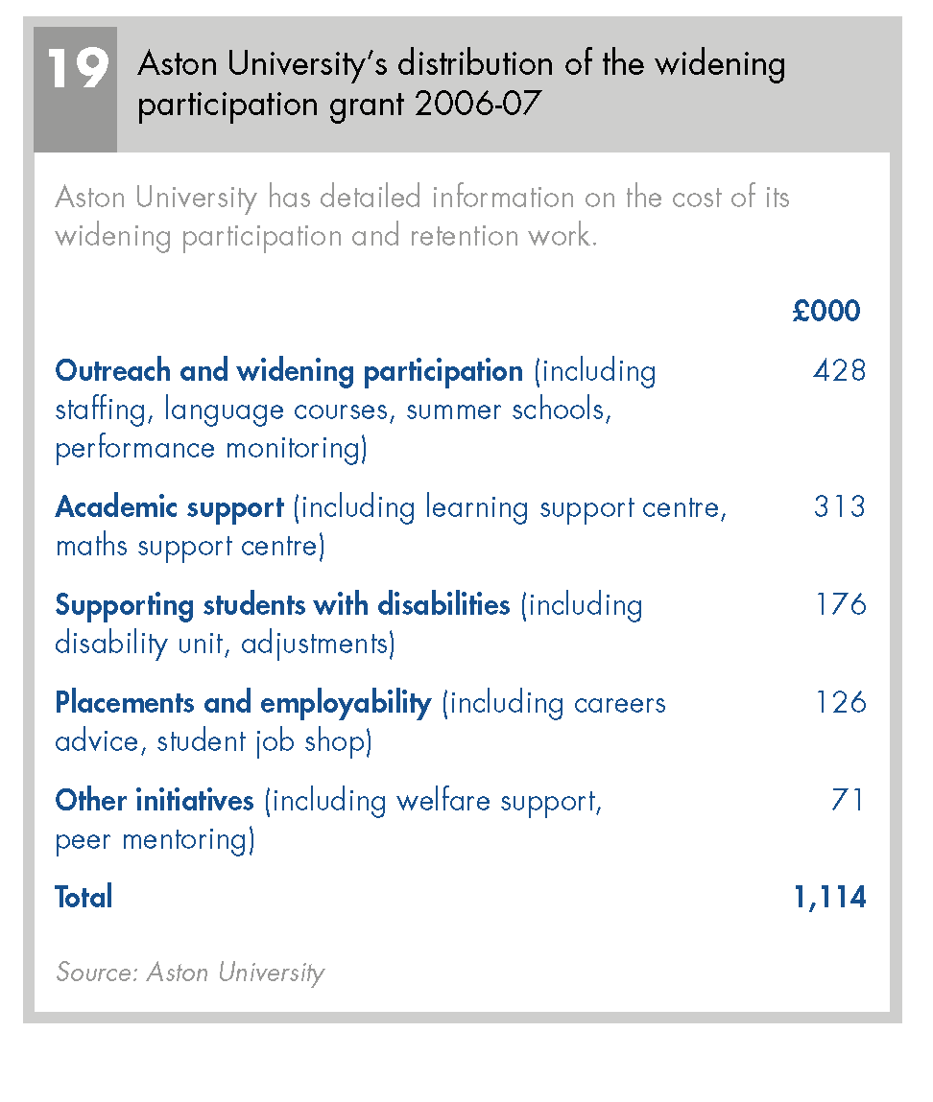
9. Individual adjustments take / waste time

Slide 22
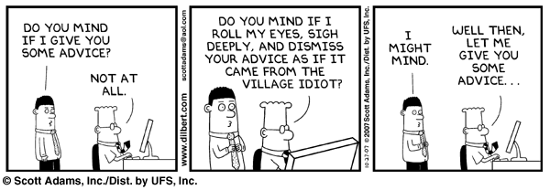
The role of the disability adviser

Slide 23
10: Aligned with staff values
The invisible hand
Informed committed action : praxis
Aristotle
Adam Smith

Slide 24
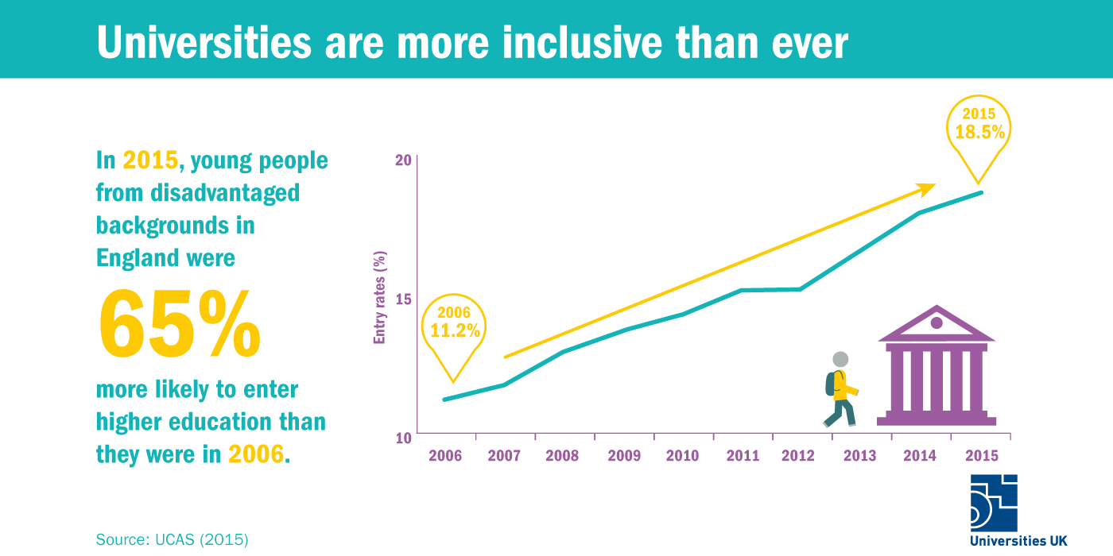
Progress report for UK HE
Policies, practice, Procedure?
Lecture capture = inclusion?
Assessment: the elephant in the room?
Inertia, Brexit, change, pressure, pariahs

Slide 25
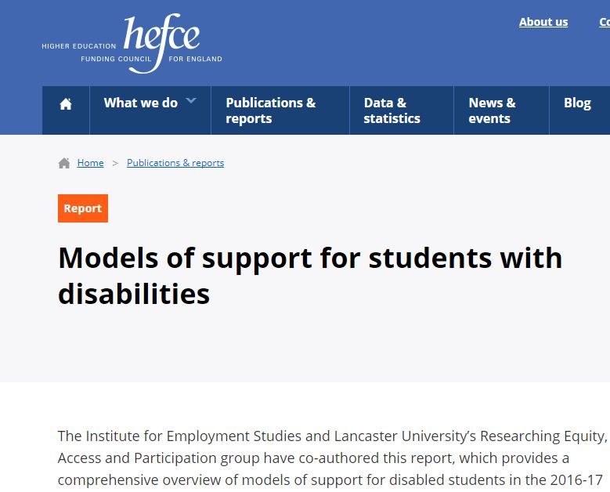
Latest HEFCE Whys and Wherefores
Summary from a survey of 105 HE providers and 13 case studies. 45 per cent say expectations of inclusive teaching and learning embedded within formal programme and module review 78 per cent use lecture capture but only 20 per cent record more than half of all lectures 88 per cent provide lecture notes in advance but 45 per cent of these do so for all students n.b. accessible? 92 per cent provide alternative assessment methods for disabled students but on a case-by-case basis.

Slide 26
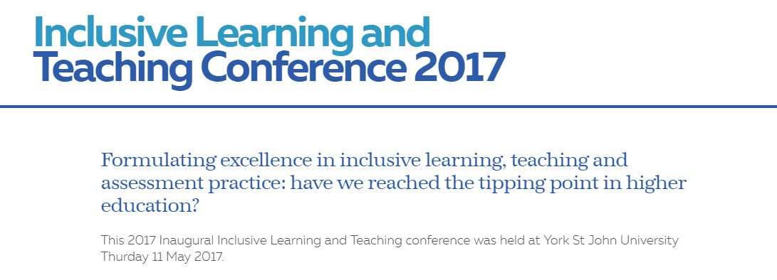
Good practice guidance
Resources: https://www.yorksj.ac.uk/add/learning-and-teaching/continuing-professional-development/learning-and-teaching-conference-2017/
rom

Slide 27

Harvard Hip Hop
The first rap album ever submitted as a senior thesis in the English Department... It was awarded a grade of summa cum laude minus. .. After graduation, Shaw will move to Seattle for a one-year internship in software engineering.

Slide 28

hello@petequinnconsulting.co.uk / mike@petequinnconsulting.co.uk
@peteqconsult https://inclusioninhe.com/

