Slide 1

Inclusive Derby: Creating an inclusive practice culture and the challenges of institution wide change
Laura Hollinshead University of Derby
Notes:
Learning technology Advisor

Slide 2

Aims of Inclusive Derby
Notes:
Derby aims to be seen as an inclusive institution which supports all of its students to succeed.
Created in 2015 as a result of changes to DSA the group aimed to mitigated the impact on new students who would no longer receive funding
Raise awareness in staff about these changes and the importance of inclusive practice
Move beyond this dialogue to talk about the benefits of inclusive practices more generally
Bring together important roles form across the institution to work together in order to make Derby more inclusive

Slide 3
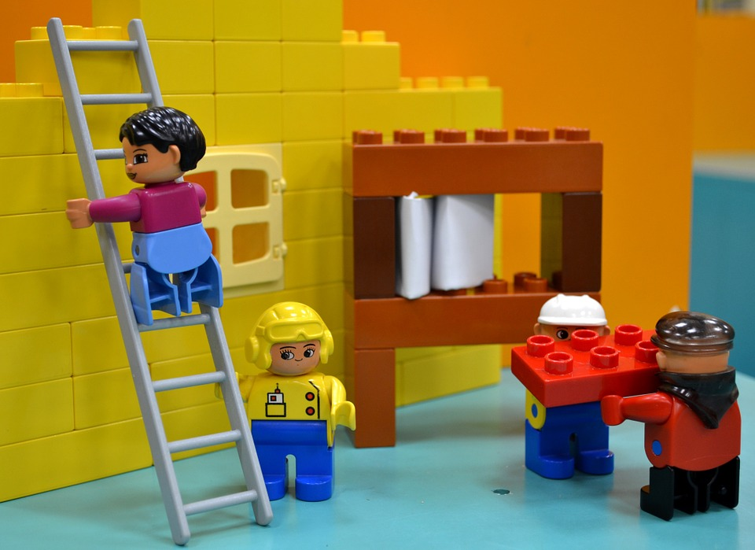
Working Group
Notes:
Learning and Teaching
Student Wellbeing
Student Experience
Technology Enhanced Learning
Marketing
Library
IT

Slide 4

Top Four Actions
4
Notes:
Set out by setting out the top four actions to support students – these were reinforced by the VC and PVC Academic and Student Experience
1. Provide lecture notes 48 hours in advance of the session, as appropriate.
2. Use lecture recording to capture appropriate teaching sessions (didactic and where you expect students to take notes)
3. Use good practice when creating documents, presentations, video and audio to make them more accessible.
4. Talk to Student Wellbeing about any concerns regarding individual students

Slide 5

Staff Development and support
Notes:
A wide range of Equality and Diversity events already available
A number of staff development events for staff to attend focused on inclusive learning and teaching practice:
Technology to support inclusive practice
Inclusive learning and teaching

Slide 6

Strategies for success
Notes:
Embedded in our institutional strategies related to learning and teaching but in particular in the Assessment and Feedback Strategy and the Technology Enhanced Learning Strategy
L&T Strategy: Promote inclusive and flexible learning provision which meets the diverse needs of different learners, and provides an environment in which learners are effectively supported in their transition through the different stages of their higher education journey
Assessment and Feedback Strategy: Core theme: Inclusive and authentic assessment and key aim To develop fully inclusive approaches to assessment and feedback
TEL Strategy: Digital practice benchmarked on inclusive elements and Invest in research in the digital experience which includes 'inclusive practice'

Slide 7

Inclusive Derby Audit
Institutional Audit
Notes:
We commissioned an Inclusive Audit
Physical audit of Kedleston Road Campus
Digital Access Audit of VLE, E-Books and intranet
Lots of positives and a number of areas to work on:
Inparticular – Website and intranet accessibility, Accessibility of VLE content, sign posting around campus, access to student tap in for attendance, hearing enhancement systems

Slide 8

Future Plans
Notes:
Departments are creating action plans to address issues identified in the audit
Inputting into Marketing rebrand and guidance around producing materials
Strategic alignment to other groups in the University
Focus on improvement on inclusive learning and teaching

Slide 9

Website and student intranet
Notes:
The website and the student intranet called UDo are having a refresh and the teams looking at these are considering accessibility as part of this work. Making sure these systems, often one of the first experienes students have of the University are easy to navigate, logical in structure and provide the information students need in an accessible format.
Working with consultants to help ensure accessibility of these developments
We want these to be ‘born inclusive’

Slide 10

New Tools
Notes:
Bringing in new tools to help both staff and students
Introduced as a quick fix the Atbar has been put onto staff and student machines – change the look and feel of websites (text enlargement, font style and colour changes, text to speech, a dictionary, spell checking, word prediction and colour overlays).
ReadSpeaker – Text to speech for our VLE Blackboard
Ally in Blackboard – Provides alternative formats and educates people on how to improve accessibility of materials

Slide 11

Biggest Challenge
Notes:
The biggest challenge we face is to bring about a cultural shift where inclusive practice becomes embedded in everyday activities
That people across the University (teaching and professional support) see the value and purpose in understanding the importance of inclusivity and putting this into actions.

Slide 12

Questions

