Slide 1
Beyond DSAs:
Reflections on a year of in-house NMH provision
December 2017
Eleanor Girt-Izod
Disability Adviser: Disability Resource Centre
University of Cambridge

Slide 2
Overview
The future of DSAs
Cambridge’s response
How it works
Benefits
Evaluation
Q&A

Slide 3
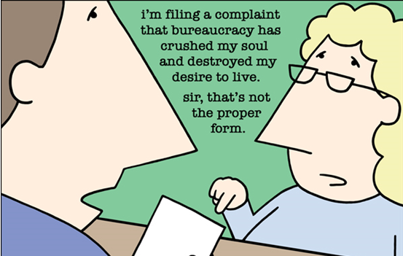
‘it’s all about value for money…’

Slide 4
Pre DSAs ‘Modernisation’
DSAs
Institutional Reasonable Adjustments
Inclusive teaching and learning environment

Slide 5
Post DSAs Modernisation
DSAs
Institutional Reasonable Adjustments
Inclusive teaching and learning environment

Slide 6
2022?
DSAs
Institutional Reasonable Adjustments
Inclusive teaching and learning environment

Slide 7
Response to DSAs Modernisation
Establish Reasonable Adjustment Fund (RAF)
  Include Specialist Mentoring and Study Skills with NMH bands 1&2
  Protect quality of NMH support and student experience
  Retain experienced NMH workers
  Reduce time and financial cost of DSAs bureaucracy
  Allow control and innovation in provision in response to student feedback
  Some NMH tasks devolved
Work to develop more effective inclusive teaching and learning practice
  E.g. Digital Education Strategy, Learning and Teaching Strategy
  Cambridge Centre for Teaching and Learning http://www.teachingsupport.cam.ac.uk/
Notes:
DSA2 only went down by 10 in 2016/17

Slide 8
Student voice
Proposals developed in conjunction with Cambridge student unions and supported through Cambridge committee structure by CUSU Education and Welfare officers
Students are still encouraged to apply for DSAs
Students have requested more flexible modes of delivery to reflect their academic context (group sessions over subscribed x 3)
Students requested support workers who have a deep understanding of their academic context
Quality Assurance matches or exceeds DSA QAG QAF standards

Slide 9
Previous NMH process under DSAs (application to NMH support)
Student Contacts DRC
DA Assess DSAs yes/no
Student completes DSAs form
SFE eligibility decision DSA1
Student goes for NAR
NAC report to student/ SFE/DRC
SFE Support approval DSA2
DRC Sets up NMH support
2 - 3 months
At least 9 separate DSAs streams for NMH to administer

Slide 10
Cambridge NMH process
DRC determines eligibility and support requirements
DRC Sets up NMH support
Student Contacts DRC
Student completes simple on-line support form
Was anticipated as 2-4 weeks, but average award from application to award actually processed in 3 days
Only one ‘stream’ applicable to all students.

Slide 11
NMH provision at Cambridge from Sept. 2016
Covered by RAF
Note-takers
Proof reader
Study Assistant
Specialist Transcription
Mentoring
Specialist Study Skills
Devolved to Departments and Colleges
Practical Support Assistant
Library Support Assistant
Workshop / Lab assistant
Examination Support Workers
Covered by DSAs
Sighted Guides, Mobility Trainer, BSL Interpreters, AT Training, Electronic Note-takers, Support workers for Deaf students.

Slide 12
Benefits of the system:
Student Experience -Time/quality
TEF/OFFA/HEFCE/CMA
Safeguarding Systems
Retention and Achievement
Protect NMH workers
Meeting legal duty
Mixed modes of delivery
Move away from medicalised process and systems
Reduced costs/time
Increased responsiveness
Increased take-up

Slide 13
Evaluation – data – student take up of support
77% increase in take up of study skills
37% increase in take up of mentoring

Slide 14
Evaluation – data - volume

Slide 15
Evaluation – student feedback
I was told about the Reasonable Adjustments funding very quickly and my application was processed very quickly, which was very helpful as it provided me with additional support quickly.
Exceptional. Above and beyond.
I strongly encourage others in a similar situation to seek out advice from the DRC, as in my experience, relatively small but intelligent interventions can really be transformative in allowing disabled students to fully realise our potential
Mentoring and Study Skills gave me many tools for success
This service is outstanding and helped me pass my viva up-grade with confidence
I am especially enthusiastic about specialist mentoring, it has completely changed my experience of study for the better

Slide 16
Evaluation – staff feedback
I had concerns about the pressures the system would put on Advisers, but I’m a convert. The RAF allows us to put support in much more quickly where there is a need, without the student or the advisers going through seemingly bureaucratic hoops. It also means we follow through with what we’re offering students. I haven’t had to spend time arguing with SFE over semantics in medical evidence, which has meant I’ve had more time to support both students themselves and the faculties/Colleges who also work with them. Keeping the support ‘in-house’ means that we’ve also maintained the strong links with the mentors and Study Skills tutors and quickly share relevant information or raise concerns.’

Slide 17
Evaluation – staff feedback
In summary, I would say that the RAF has given me much more control over managing student support. Support can be put in place at short notice, additional hours for non-medical help can be added quickly, as appropriate. We can respond much more effectively and efficiently to student need. As a Disability Adviser, it gives me peace of mind.

Slide 18
Evaluation – staff feedback
" The Fund enables my relationship with the student to start off positively. I recommend support and sometimes within a week the student is receiving it. The student then links my support with their success in their studies".

Slide 19
Evaluation – staff feedback
Moving to the RAF from DSA has had a massively positive impact on my work as a disability adviser and my ability to respond to the individual requirements of the student in an appropriate and timely way. As disability advisers, we can work with the student to identify the support that they will benefit from most, and are able to ensure that this is the support that they receive. This means that the student receives the support very quickly after discussing the issues with us (sometimes on the same day). As a result, the time disability advisers spend determining and arranging the support is productive time where we are getting good outcomes for students. Previously we wasted considerable time with back and forth emails to SFE, which were of no material benefit to students (but just caused considerable delays before support could be implemented).

Slide 20

Questions?

